Slide 1
Global Change Analysis Model (GCAM-USA): Integrated Assessment Modeling of Subnational Energy, Water, and Land Systems for the State of Maryland
October 2024
Silvia R. Santos da Silva, Ph.D.

Slide 2
Outline
Introduction
Global Change Analysis Model (GCAM)
GCAM-USA
Reference Scenario
Climate Policy (Net-Zero) Scenarios
Conclusions
2
2

Slide 3
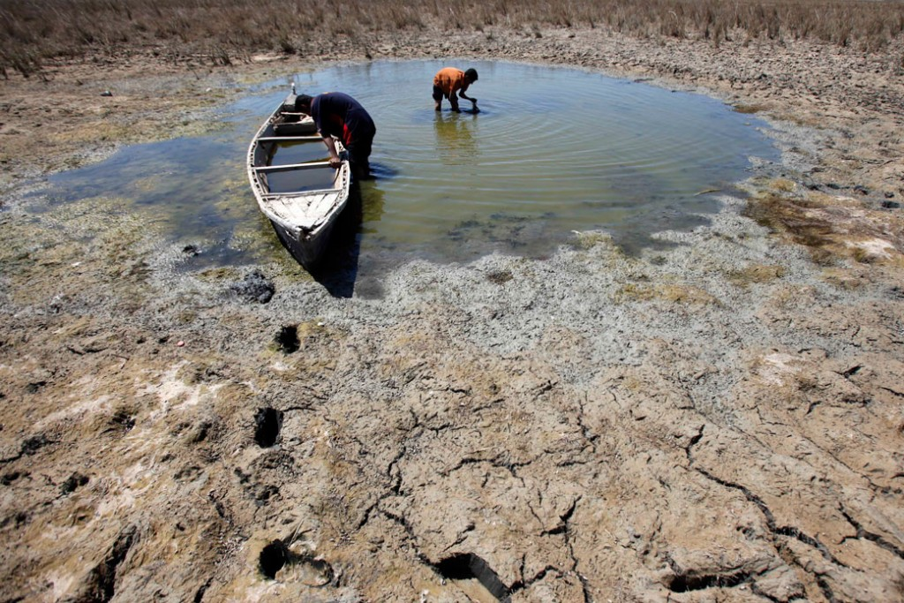
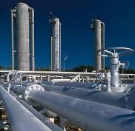
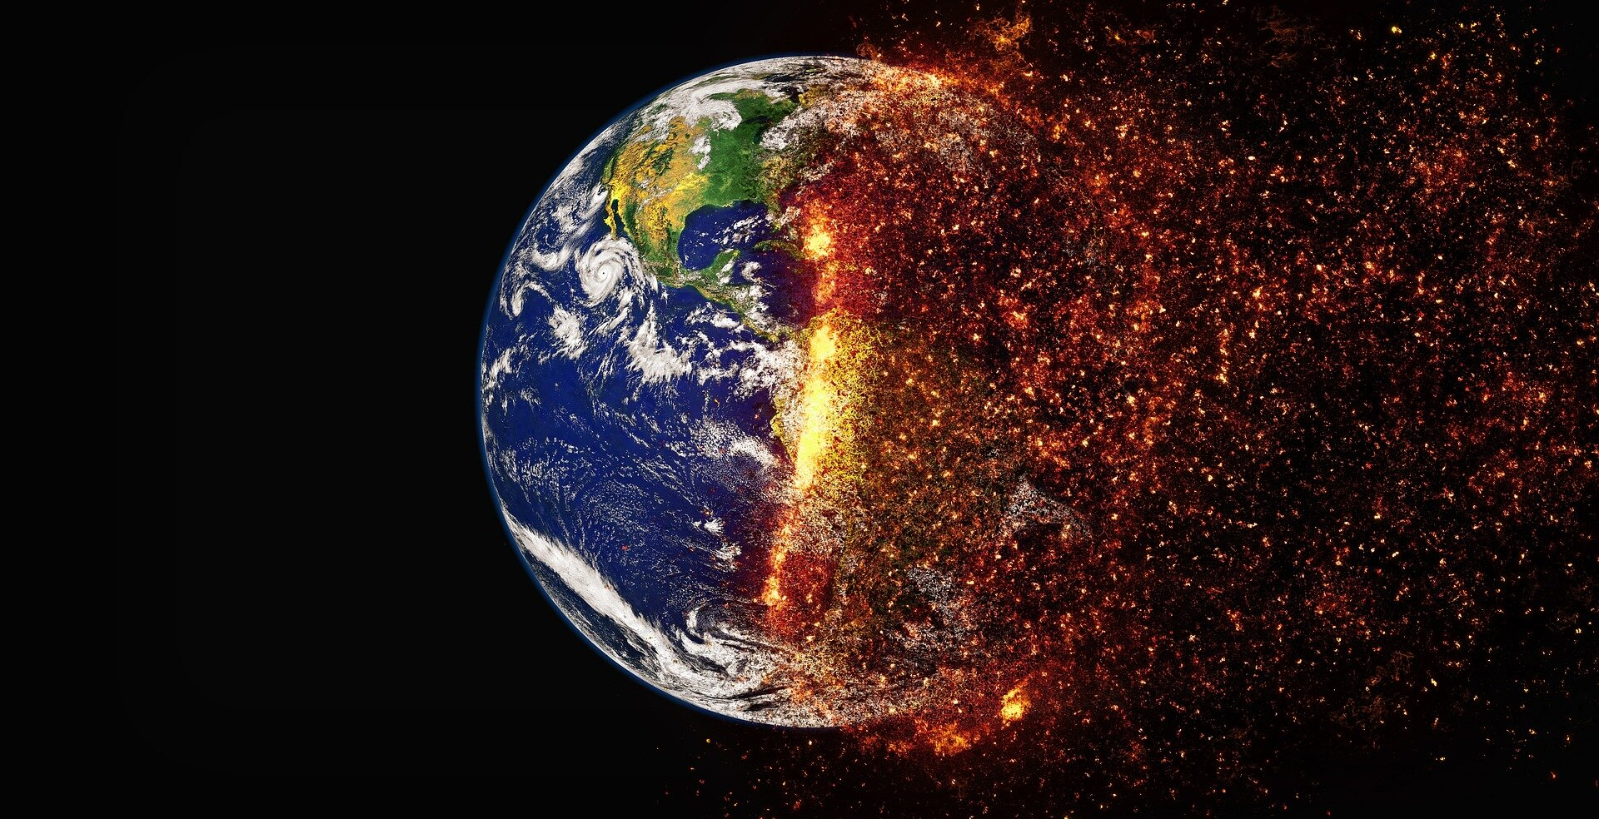
Society's "Nexus" interconnected goals and challenges
Increased food production is required to feed a world of 8 billion by 2030, 9 billion by 2050
Increased dependence on food trade exposes countries to water stress impacts abroad
Food security
Irrigation for crops creates scarcity and competition among water users (e.g., agriculture and energy), unsustainable groundwater depletion, and ecosystem impacts
Climate change is worsening flood, drought, and asset (e.g., power plant) risks
Water security
Cheap, carbon-intensive energy sources may support short-term energy security in some regions, but this contributes to long-term climate change, poor air quality, and cooling water demands
Trade-offs between water and energy requires complex, integrated management
Energy security
Humans are warming the planet by producing energy and land use change emissions
This creates steep risks for ecosystems (e.g., via drought) and human infrastructure (e.g., via floods, wildfires, hurricanes, sea level rise, etc.) that affect our ability to produce food and power
Climate change
"Integrated Assessment Models" were developed to analyze these interconnected challenges, their solutions, and resulting tradeoffs.
3
3

Slide 4
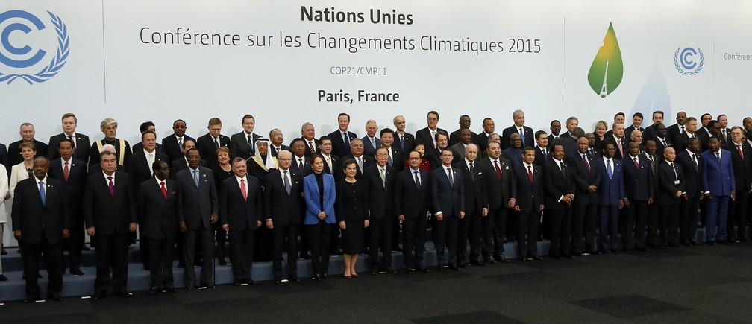
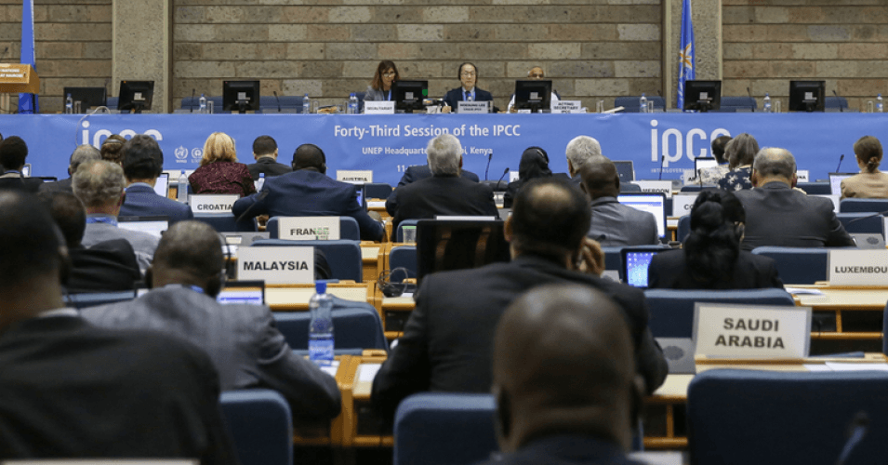
What are Integrated Assessment Models (IAMs)?
IAMs explore how human development and societal choices interact with and affect the natural world (e.g., climate change).
They integrate representations of both human and earth systems.
They have been used to (1) understand and assess the magnitude of human-induced global warming, and (2) support the identification of possible solutions and the tradeoffs they create
4
4

Slide 5
Multi-sector Human-Earth System models developed by interdisciplinary teams
Model | Home Institution
AIM Asia Integrated Model | National Institutes for Environmental Studies, Tsukuba Japan
GCAM Global Change Analysis Model | Joint Global Change Research Institute, PNNL, College Park, MD
IGSM Integrated Global System Model | Joint Program, MIT, Cambridge, MA
IMAGE The Integrated Model to Assess the Global Environment | PBL Netherlands Environmental Assessment Agency, Bildhoven, The Netherlands
MESSAGE Model for Energy Supply Strategy Alternatives and their General Environmental Impact | International Institute for Applied Systems Analysis; Laxenburg, Austria
REMIND Regionalized Model of Investments and Technological Development | Potsdam Institute for Climate Impacts Research; Potsdam, Germany
Applicable at country scale
embedded water module
5
5

Slide 6
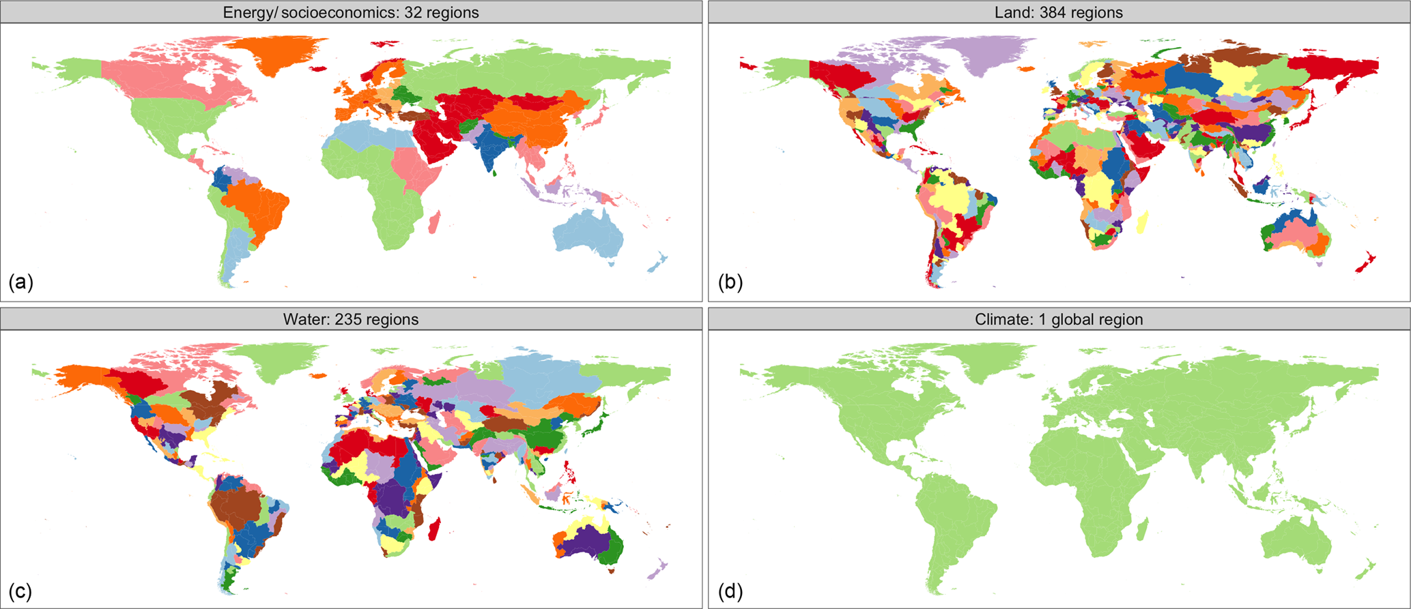
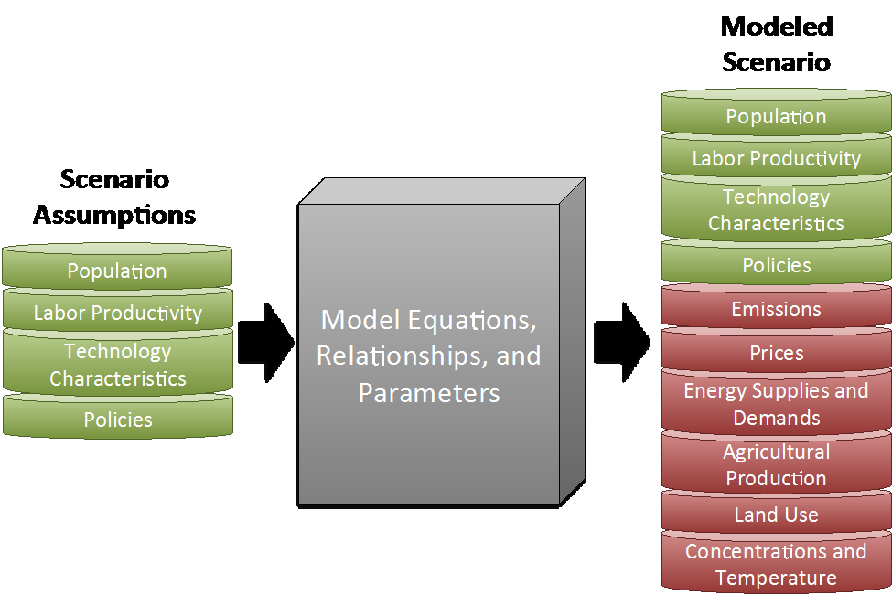
Global Change Analysis Model (GCAM)
GCAM produces conditional forecasts: GCAM scenarios help to explore a wide range of potential future energy, water, and land uses under a particular set of assumptions.
GCAM uses outputs from global climate models (CMIP5/6, ISIMIP3) and generates results driven by RCP-SSP scenarios; useful to understand the uncertainty of the different estimates.
Alignment with IPCC scenario analysis (e.g., reference, NDC, net-zero, interventions) -> GCAM is an IPCC "marker" model.
Open-source, publicly available model.
6
Source: http://jgcri.github.io/gcam-doc/overview.html
6
Systems spatial scales in GCAM (Calvin et al. 2019)

Slide 7
GCAM Characteristics
Overview: A partial equilibrium global integrated assessment model with technology-rich representations of the economy, energy sector, land use and water linked to a climate model.
Solution: A dynamic-recursive model (i.e., we do not know the future when making a decision today) that solves all energy, water, and land markets simultaneously one period at a time.
Temporal dimension:
Base (last calibrated) year: 2015
Model calibration (historical) period: 1990-2015
Time steps: Model runs in 5-year time steps
Horizon: Simulations can extend up to 2100
Spatial dimension: 32 energy-economic regions including USA, 384 land regions, 235 water basins, and 1 climate system.
Applications: Often used to evaluate impacts of socioeconomic development, climate and energy policies, technology and resource developments, etc.
GCAM Default Regions
7
7
http://jgcri.github.io/gcam-doc/toc.html

Slide 8
Some Applications of GCAM
Impacts of climate change on global water resources (World Bank 2015-2017)
Land-Energy-Water Nexus Analysis in the Middle East and North Africa Region (World Bank 2017-2018).
Climate-Land-Energy-Water-Socioeconomics Nexus in Latin America and Caribbean Region (World Bank, 2018-2019).
Support of NDC Analysis in Argentina, Uruguay, Colombia (Inter-American Development Bank, 2018-2021).
Support of Climate Change and Development Reports (World Bank, 2021- present): National level analysis of water-energy-food nexus in over 20 countries in Africa, LAC, ECA, South Asia regions.
GCAM has been used to support policy development (“Valuation of Water”) in Saudi Arabia.
GCAM-USA: county-level GCAM for the US, used to analyze climate-energy, land use and water policies across the country, recently used to develop the US Mid-Century Strategy for climate mitigation, US contributions to the Paris Agreement and follow ups.
8
8

Slide 9
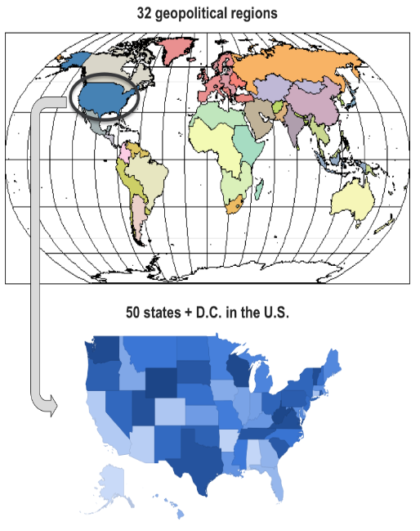
GCAM-USA
GCAM-USA: version of GCAM with subnational detail in the U.S.
The 50 U.S. states plus the District of Columbia are included as explicit regions that operate within the global GCAM model.
GCAM-USA is embedded within the global version of GCAM.
Conditions and markets in the U.S. are consistent with international conditions.
The subnational regions in GCAM-USA contain more detailed representations of socioeconomic drivers, renewable resource characteristics, energy transformation sectors, and end-use energy demands than the core GCAM (single U.S. region) model.
Core Global GCAM
GCAM-USA
Source: https://jgcri.github.io/gcam-doc/gcam-usa.html
9
9

Slide 10
GCAM-USA
GCAM-USA is useful to understand state-level contributions to climate policies to mitigate GHG emissions.
Source: Ou et al. 2023. State-by-state energy-water-land-health impacts of the US net-zero emissions goal, Energy and Climate Change, 4,.
GCAM-USA can help to evaluate a large number of other scenarios: different socio-economic development, various technology deployment paths (costs, availability, and penetration), air pollution and climate impacts.
10
10

Slide 11
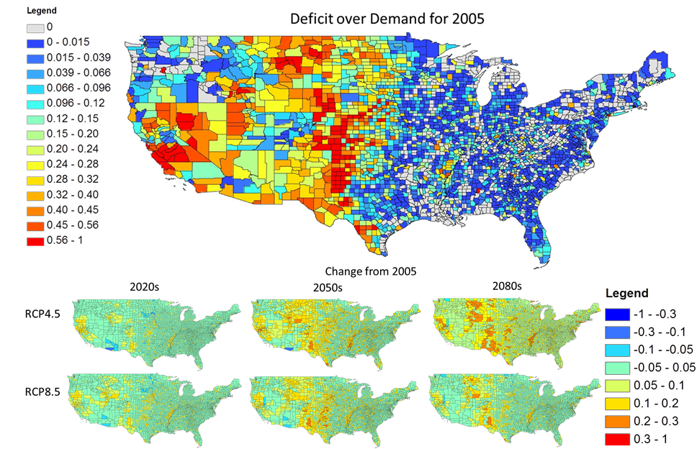
GCAM-USA
Annual county scale surface water deficit as a fraction of demand
Water deficit is projected to increase more with climate change mitigation that favors biomass
11
11
Hejazi et al.

Slide 12
GCAM-USA Reference Scenario
Scenario¹: A plausible description of how the future may develop based on a coherent and internally consistent set of assumptions about key driving forces (e.g., rate of technological change, prices) and relationships.
Note: scenarios are neither predictions nor forecasts, but are used to provide a view of the implications of developments and actions.
Reference scenario¹: Scenario used as starting or reference point for a comparison between two or more scenarios.
GCAM-USA Reference scenario²: Scenario constructed with an underlying storyline that historical trends continue in the near term due to inertia in the system and continuation of current policies; however, in the long term, outcomes are largely driven by economic forces.
Sources:
¹https://www.ipcc.ch/report/ar6/wg1/downloads/report/IPCC_AR6_WGI_AnnexVII.pdf
²https://jgcri.github.io/gcam-doc/gcam-usa.html
12
12

Slide 13
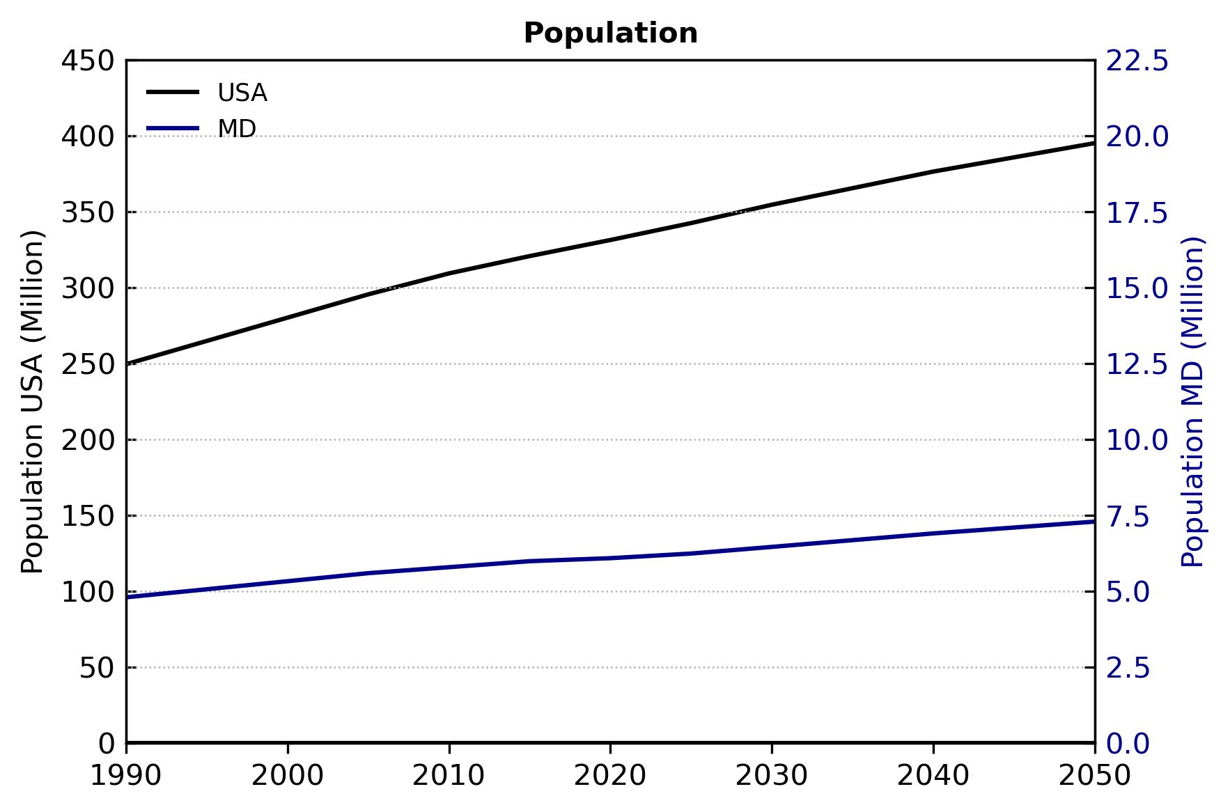
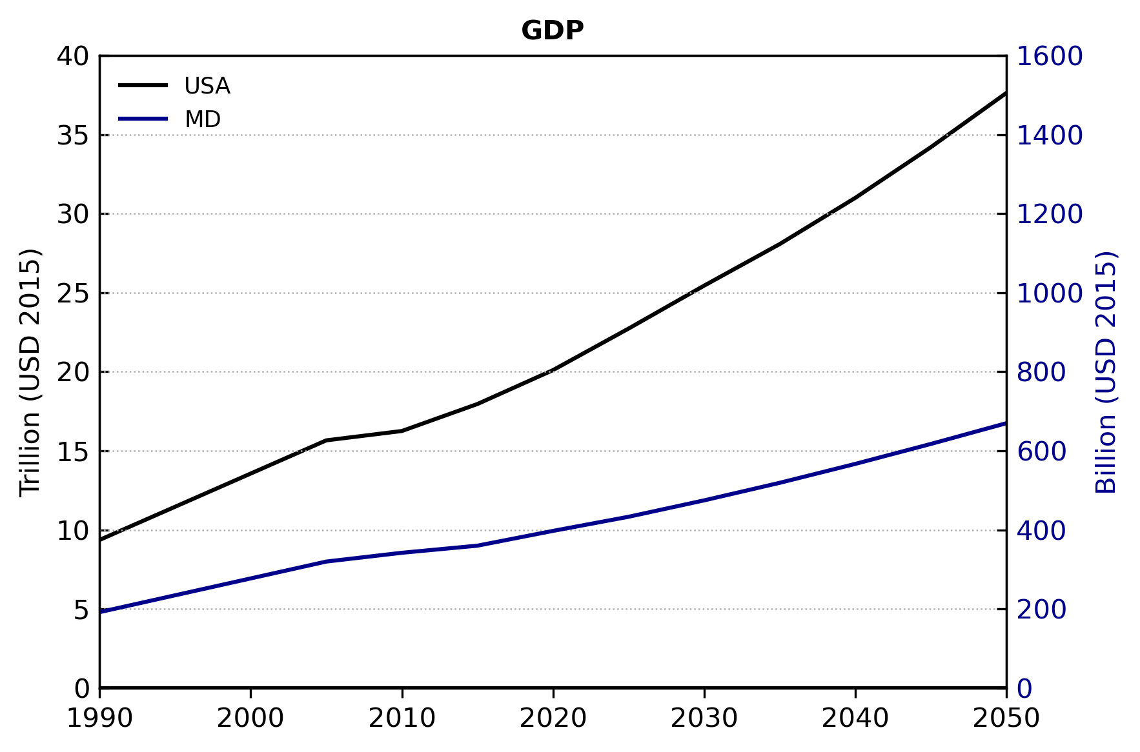
Socioeconomic Drivers
GCAM-USA Reference scenario assumes a steadily growing U.S. economy and population.
State-level population and economic growth assumptions are based on historical values through 2018.
Future population growth assumptions are based on the SSP2 “middle-of-the-road” scenario (of the shared socio-economic pathways database).
Future economic growth assumptions based on per-capita GDP growth assumptions by US Census Division from the Annual Energy Outlook 2019.
Growth (%) in 2050 relative to 2015 for MD:
Population: 22%.
GDP: 86% (average yearly growth of 1.7% between 2015 and 2050).
13
13

Slide 14
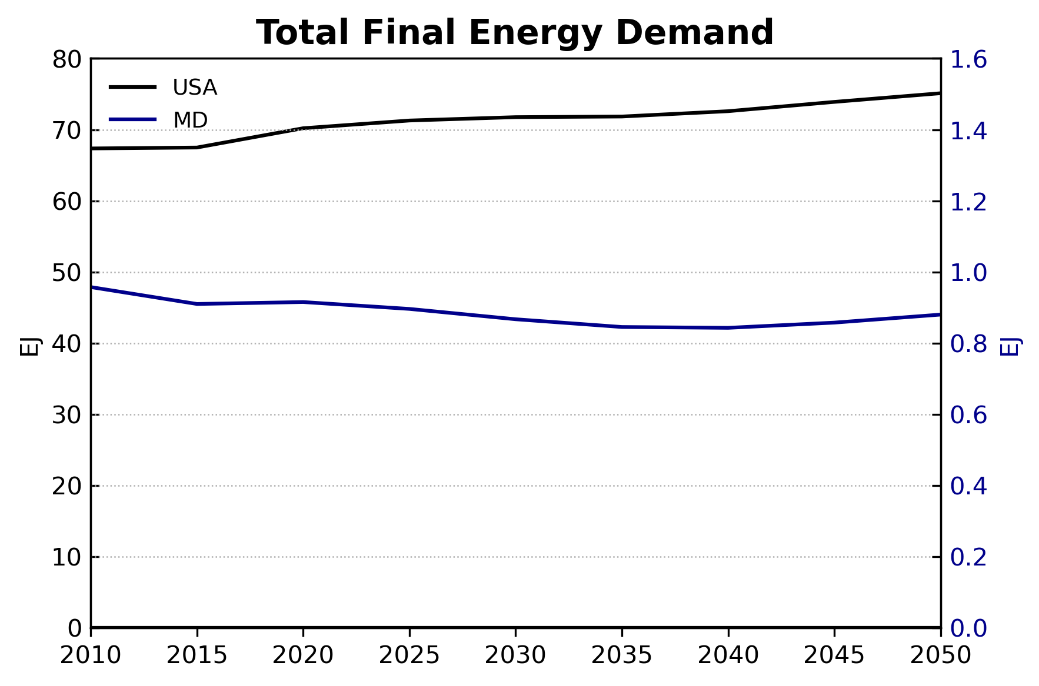
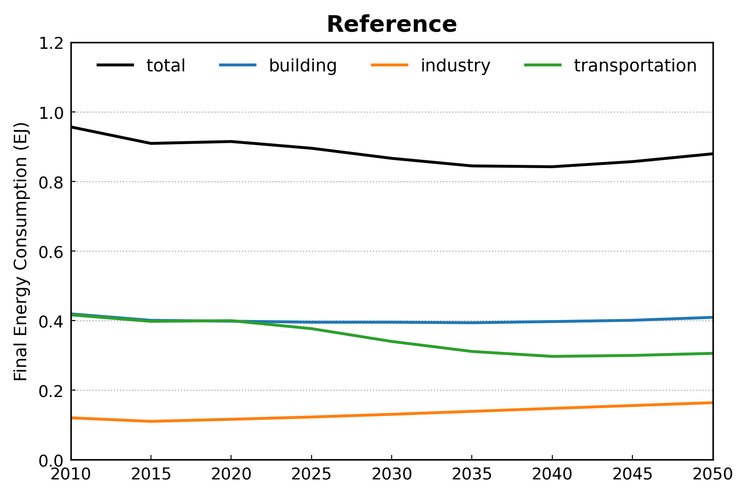
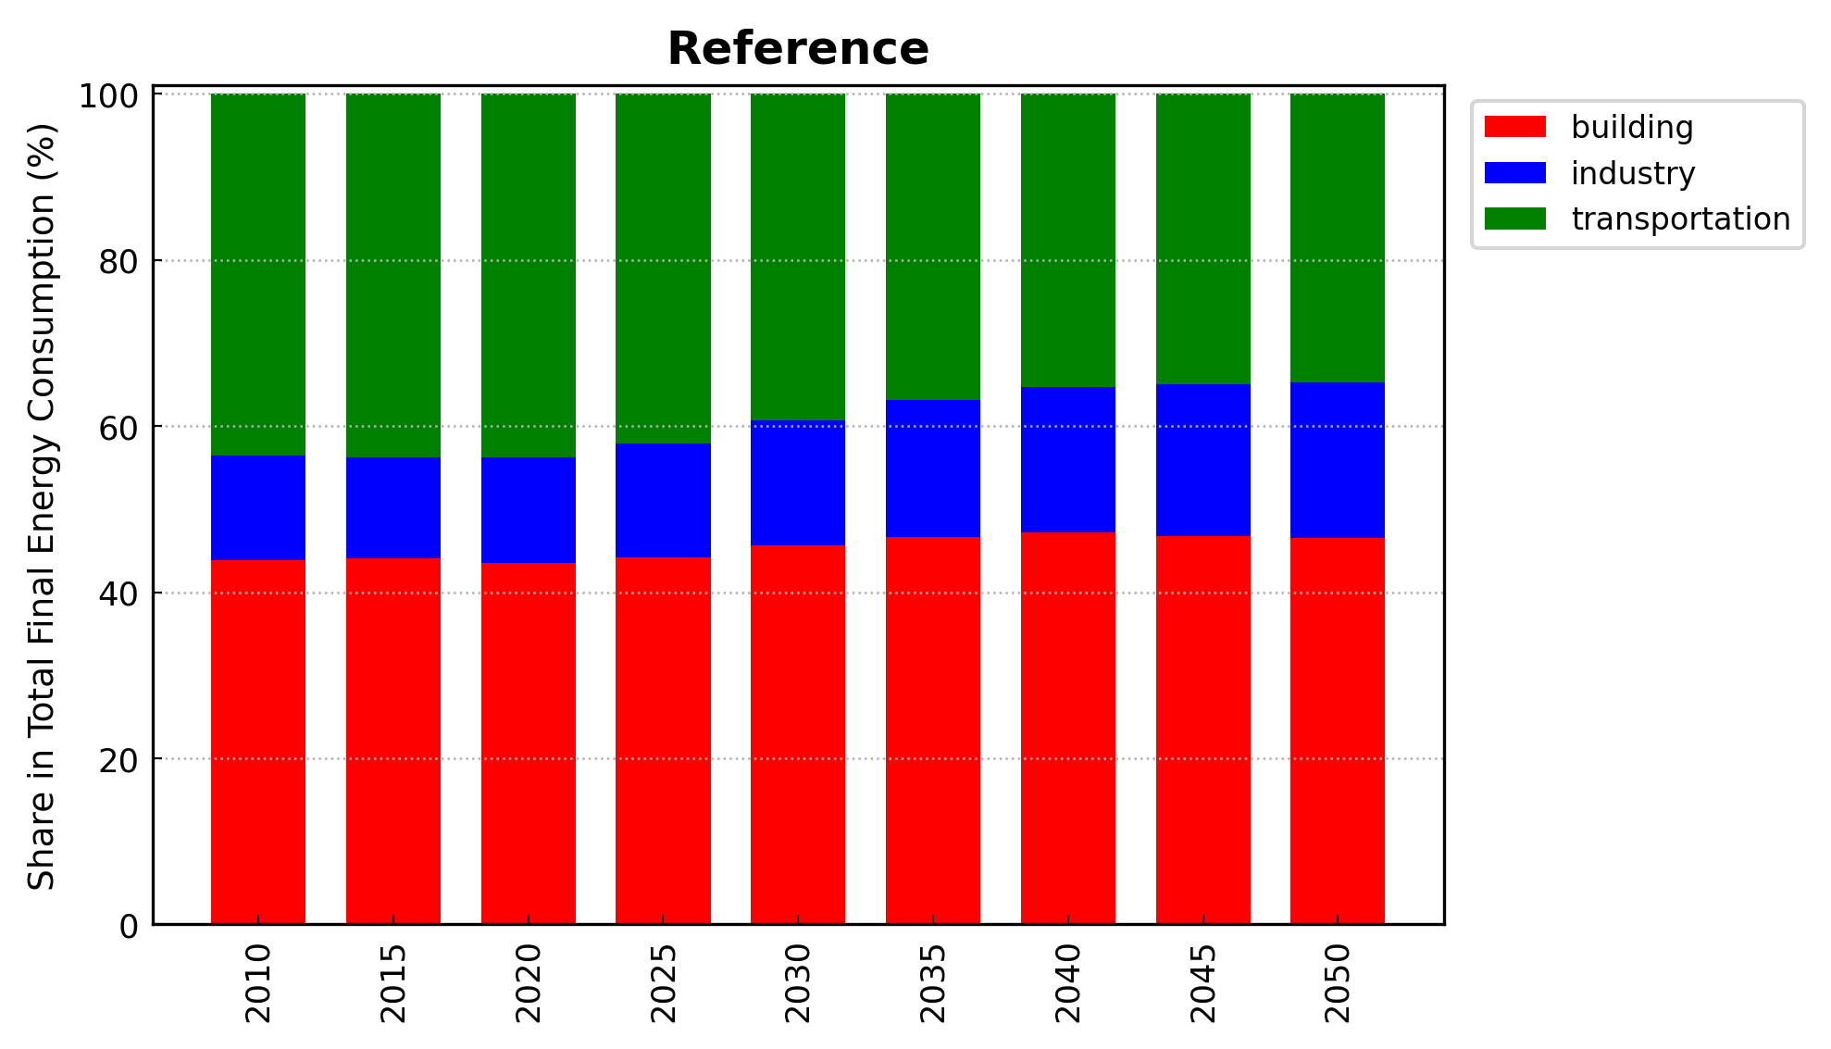
Energy Sector: End-Use Energy Demands (1)
MD
MD
Overall, population and economic growth drives increasing service demands in all end-use sectors.
The GCAM-USA Reference scenario assumes a continuation (but not an expansion or strengthening) of current energy efficiency policies (e.g., building efficiency standards).
USA: total final energy demands increase as efficiency improvements are slower than increases in demand for end-use energy services¹.
This balance between population and income driven demand growth and service efficiency varies by states and sectors.
MD: total final energy demand slightly declines by 2050 mostly due to efficiency improvements in the transportation sector.
14
14
¹ End-use energy services include space heating and cooling, passenger and freight transportation, industrial energy use, etc.

Slide 15
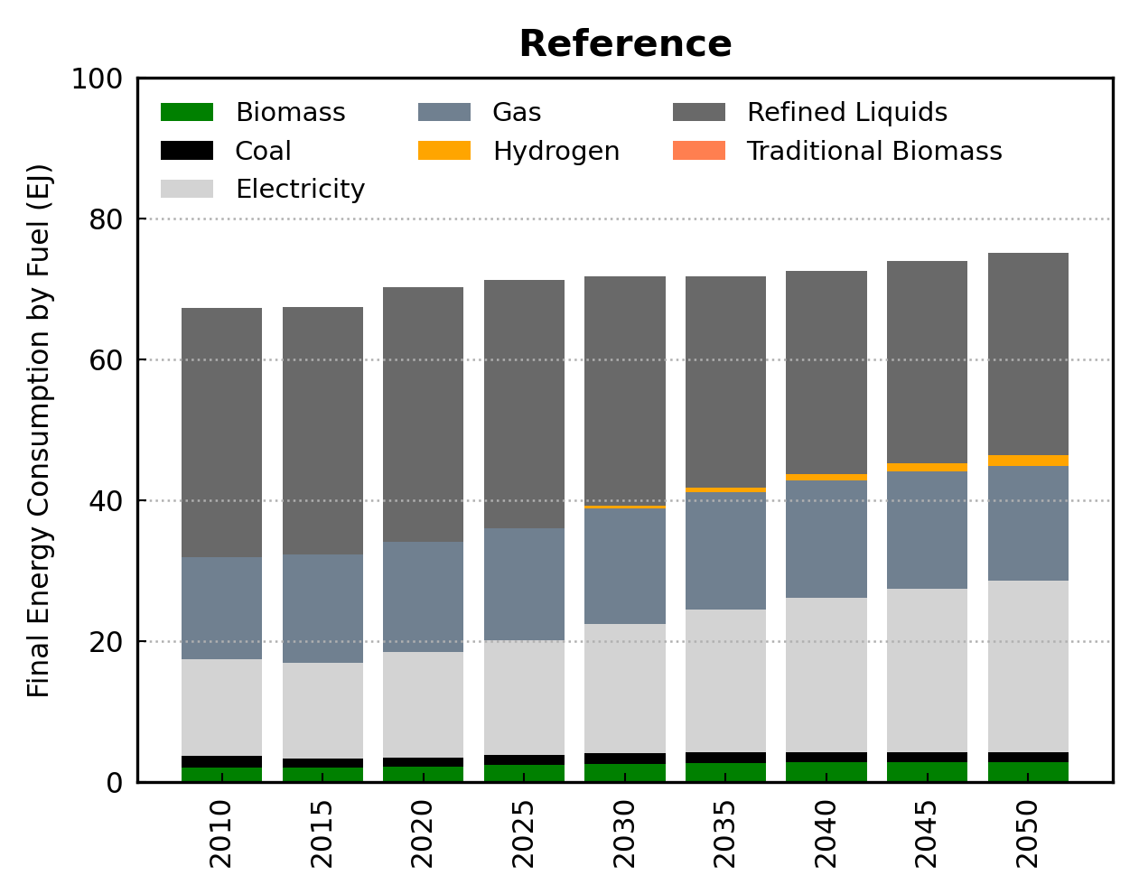
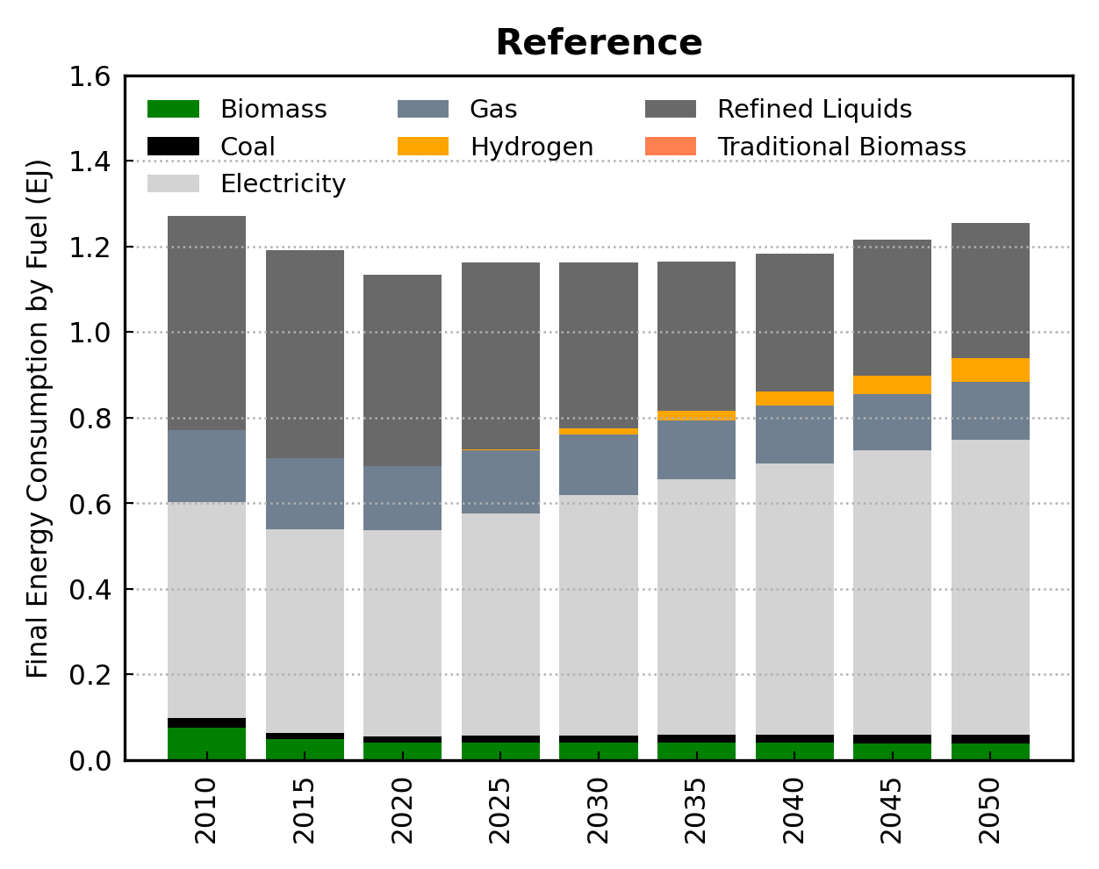
Energy Sector: End-Use Energy Demands (2)
USA
MD
End-use sectors tend to become increasingly electrified over time, particularly the buildings sector (where many new energy demands come from electronic devices).
Although the transportation sector remains reliant on liquid fossil fuels, light-duty vehicles (LDVs) are projected to electrify more rapidly than the sector as a whole.
Note: The GCAM-USA Reference scenario does reflect existing policies to incentivize battery electric vehicle (BEV) deployment.
15
15

Slide 16
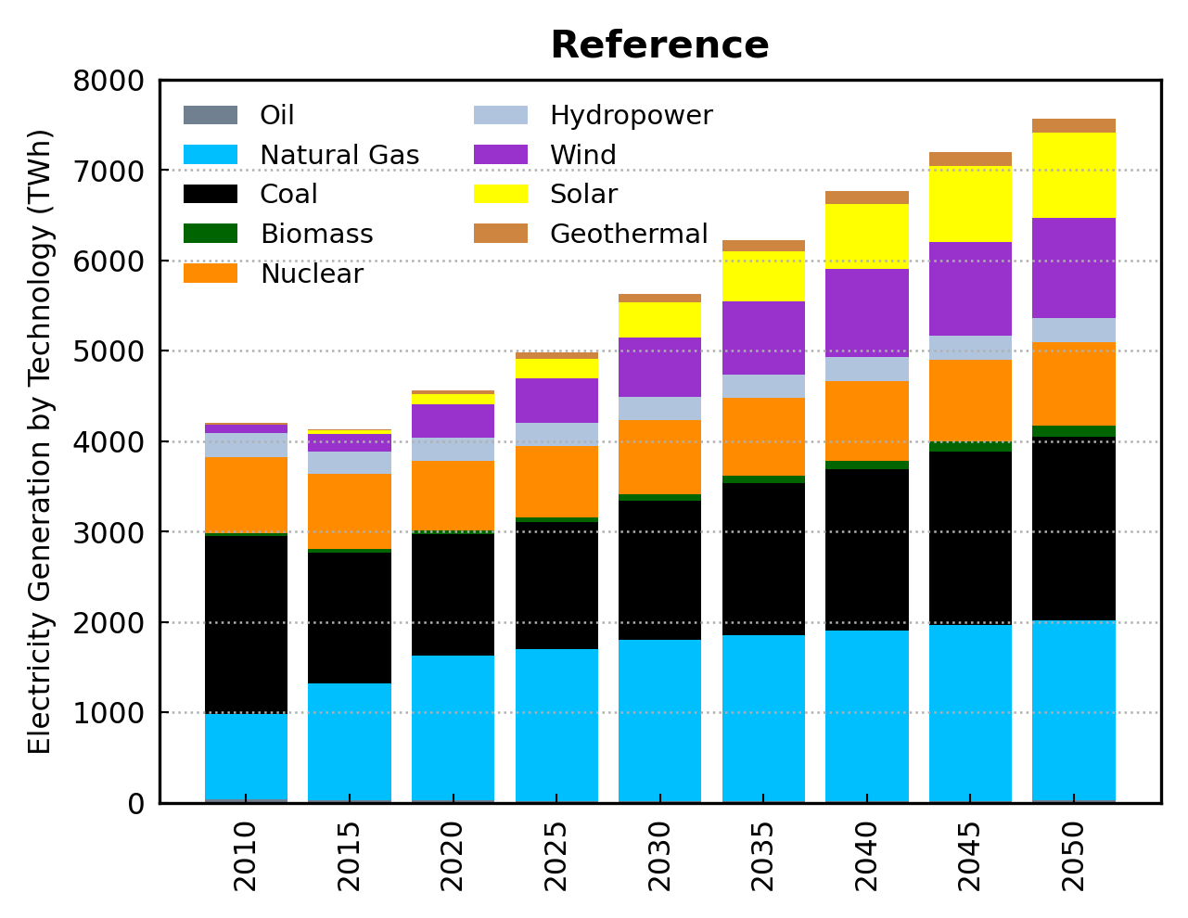
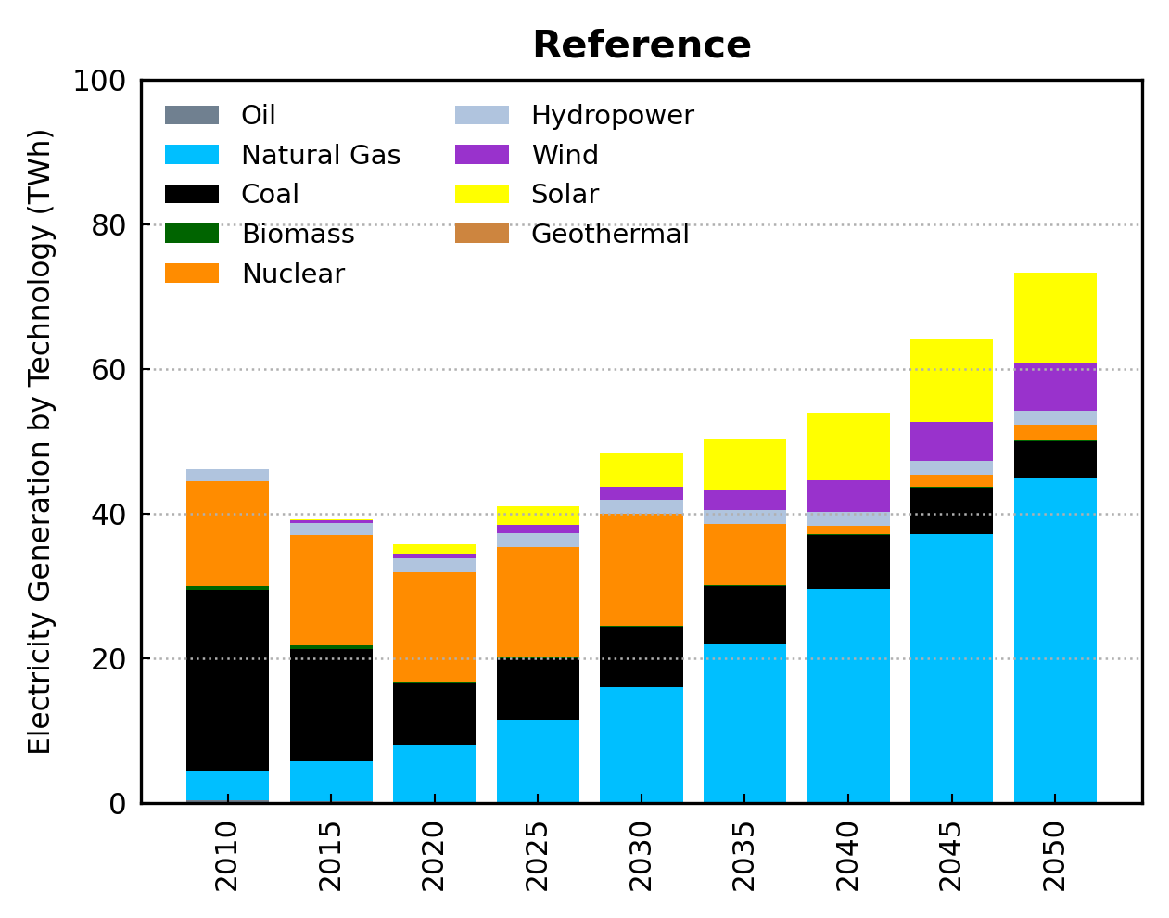
Energy Sector: Electric Power (1)
USA
MD
Rising electricity demand is met by increasing generation from natural gas and renewables in the Reference scenario.
The GCAM-USA Reference scenario assumes no new deployment of coal-fired power plants without carbon capture and storage (CCS), based on the Clean Air Act Section 111 (b) New Source Performance Standards (Environmental Protection Agency, 2015).
16
16

Slide 17
Energy Sector: Electric Power (2)
USA
MD
MD: coal generation remains roughly flat from 2020 to 2040, but remains a substantial portion of the generation mix through 2040. In the post-2040, much of the capacity reaches the end of its technical lifetime.
The Reference scenario assumes rather limited deployment of nuclear technologies in the U.S., to reflect common understanding that the deployment of nuclear technologies is constrained by economic, institutional, and social factors including concerns regarding nuclear waste disposal, safety, and security.
MD: nuclear generation flattens in the coming decade followed by reduced generation after 2030.
17
17

Slide 18
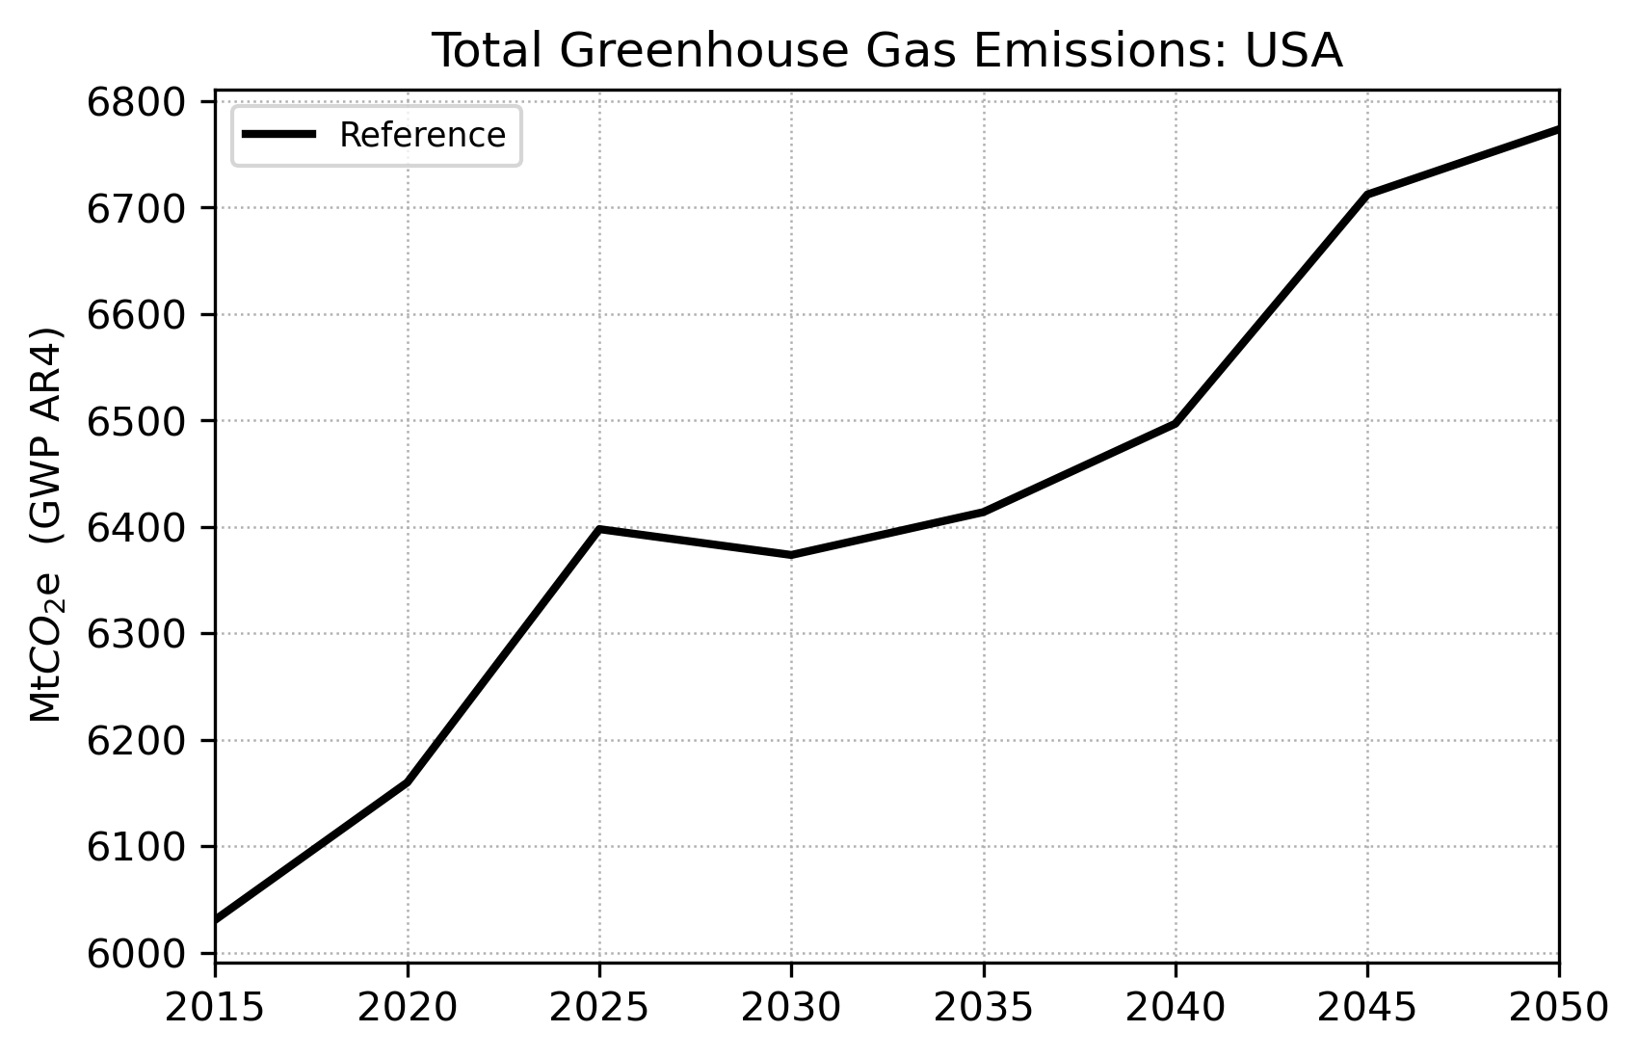
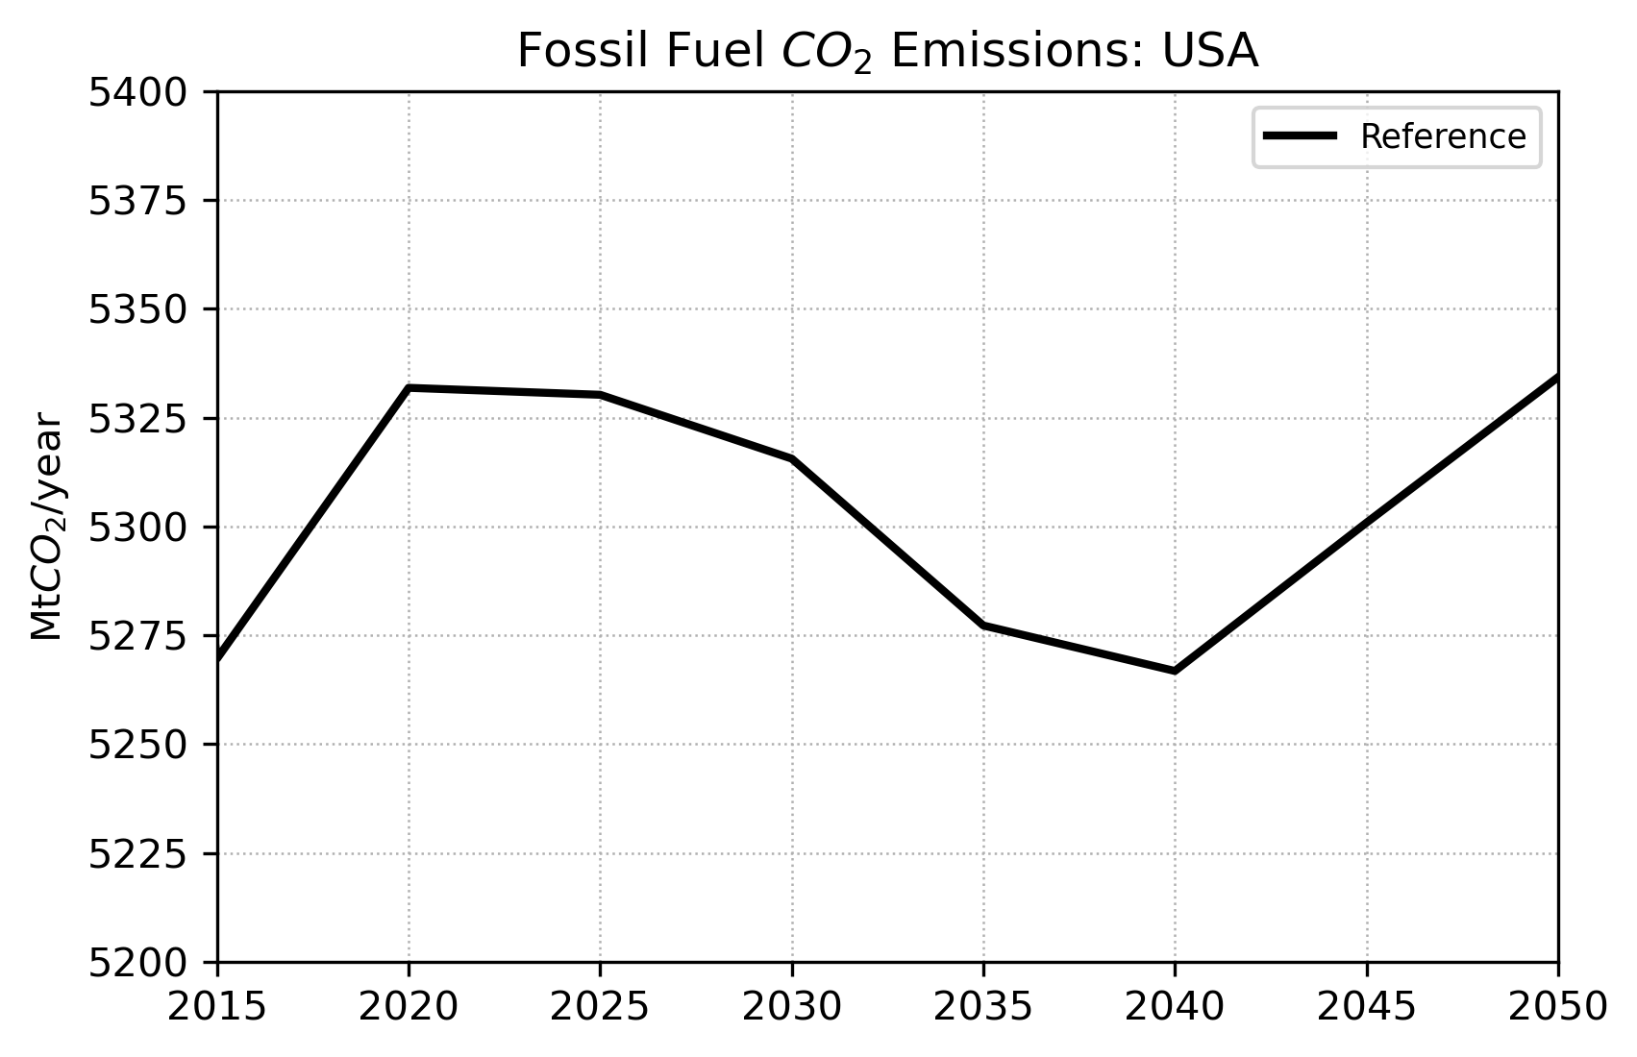
Greenhouse Gas (GHG) Emissions (1)
Historically, total GHG emissions in the US has been dominated by CO₂ emissions from energy and industry.
Largest fossil CO₂ emitters: electricity and transportation sectors.
Without measures to mitigate climate change, the Reference scenario projects that fossil CO₂ emissions in the post-2025 period will remain within a range similar to present-day levels.
However, total GHG emissions are projected to continuously grow by 2050 due to larger contributions from the AFOLU¹ sector.
Adapted from Ou et al. 2023.
18
¹AFOLU: Agriculture, Forestry, and Other Land Use.
18

Slide 19
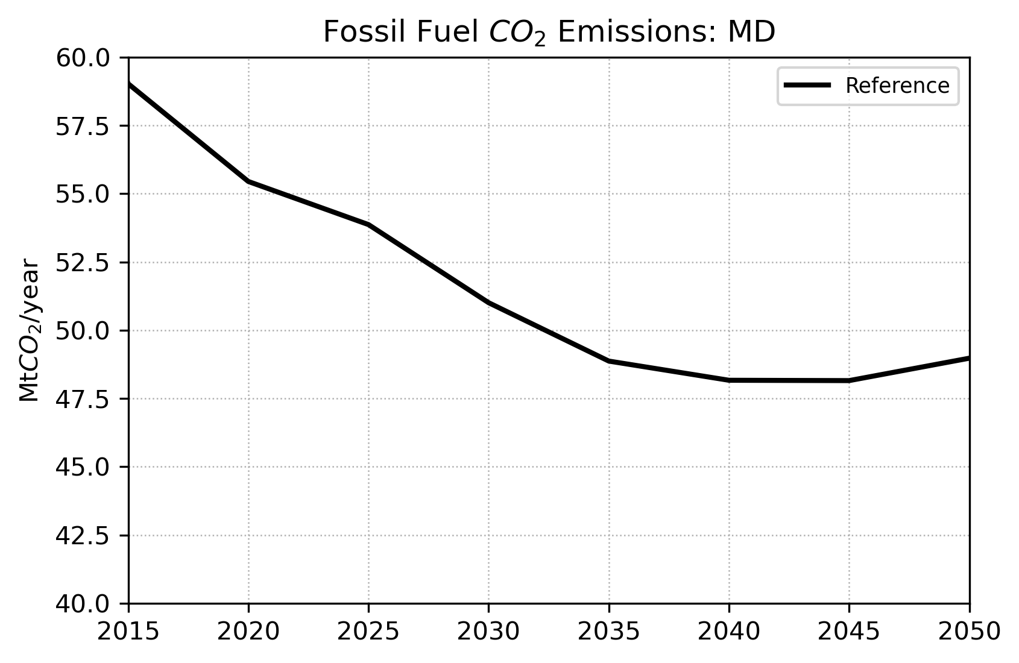
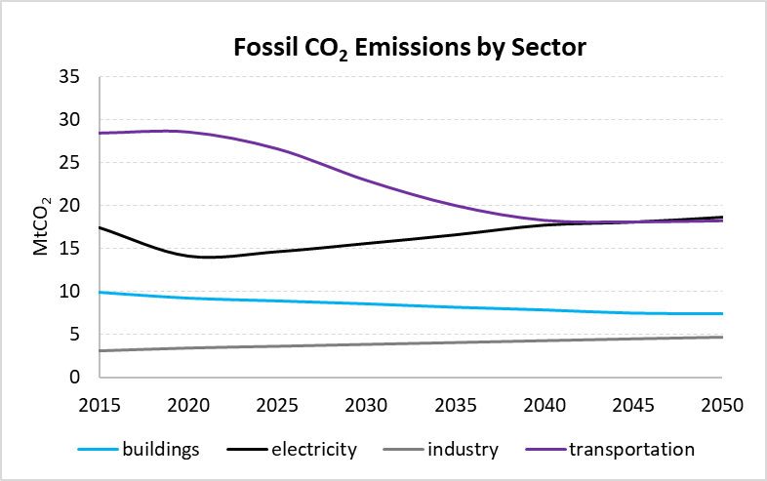
Greenhouse Gas (GHG) Emissions (2)
TX
CA
MD is among the bottom 23 state contributors to the national total CO₂ emissions.
Fossil CO₂ emissions in MD is projected to decline by 2050 mostly due to reductions in the transportation sector.
On the opposite trend, emissions from the electricity sector steadily grows in the upcoming decades highlighting the need of actions to decarbonize this sector.
MD Fossil CO₂ Emissions in MtCO₂ (MD Rank among 51 states):
2015: 59 (32nd)
2020: 55 (33rd)
2030: 51 (34th)
2050: 49 (29th)
19
19

Slide 20
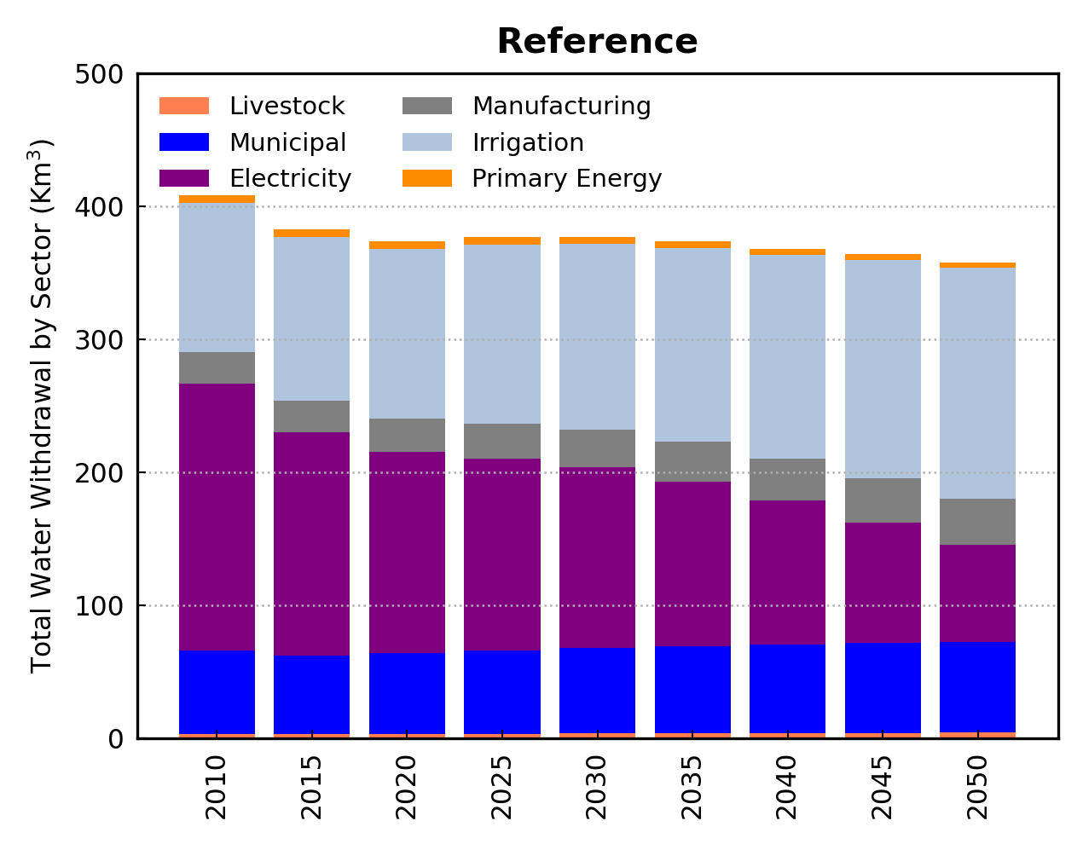
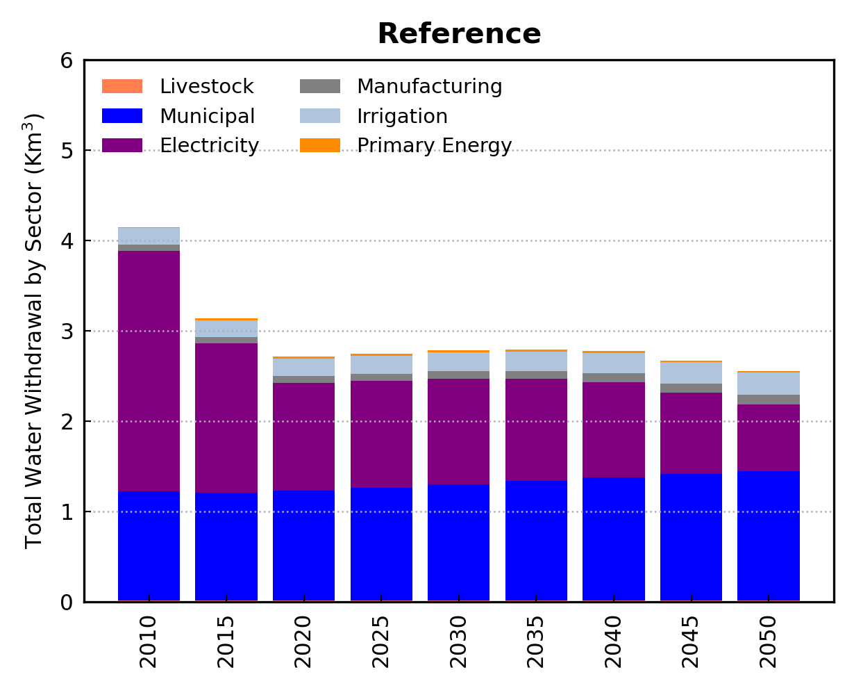
Water Sector: Water Withdrawals
USA
MD
National level: Modest declines in total water withdrawals through midcentury.
The decline is driven by a reduction in power sector cooling water.
Gradual retirement of plants with water-intensive once-through cooling systems (which are assumed to be unavailable in future periods) coupled with a shift towards less water-intensive generation technologies (e.g., natural gas, renewables).
Declining power sector water demands are partially offset by increased withdrawals from other sectors, particularly agriculture (largely driven by economic growth).
MD: Considerable reduction in total water demands through midcentury.
MD is also facing considerable reduction in electricity-sector water demands. However, the demand increase in other sectors are much less pronounced than at national level.
20
20

Slide 21
Climate Policy (Net-Zero) Scenarios
During the 2021 United Nations climate conference, the US announced its updated climate pledge “to reduce net greenhouse gas emissions by 50–52 % in 2030 relative to 2005 levels” and to reach “net-zero emissions no later than 2050”.
Furthermore, the US has set a goal of achieving “100 % carbon pollution free electricity by 2035”.
Such goals are expected to have profound economic and sustainability consequences.
Understanding and quantifying these impacts not only at national but also at subnational scales is important for shaping public support and in the steps of policy design and implementation.
GCAM-USA was employed for the understanding of the consequences of the recent climate goals of the US at the state level.
21
21

Slide 22
Climate Policy (Net-Zero) Scenarios
Scenario framework: developed by Ou et al. 2023.
Four different US net-zero decarbonization pathways with two national targets:
1) the US Long-Term Strategy, aiming at a 50 % net-GHG emission reduction by 2030 relative to 2005 level and net-zero GHG emissions by 2050, and
2) US power grid achieves clean-grid by 2035.
Net-Zero scenarios (table) also account for uncertainties in the availability of key low-carbon technologies, carbon removal technologies, and behavioral changes in decarbonization pathways.
Table from Ou et al. 2023 (State-by-state energy-water-land-health impacts of the US net-zero emissions goal, Energy and Climate Change, 4).
22
22

Slide 23
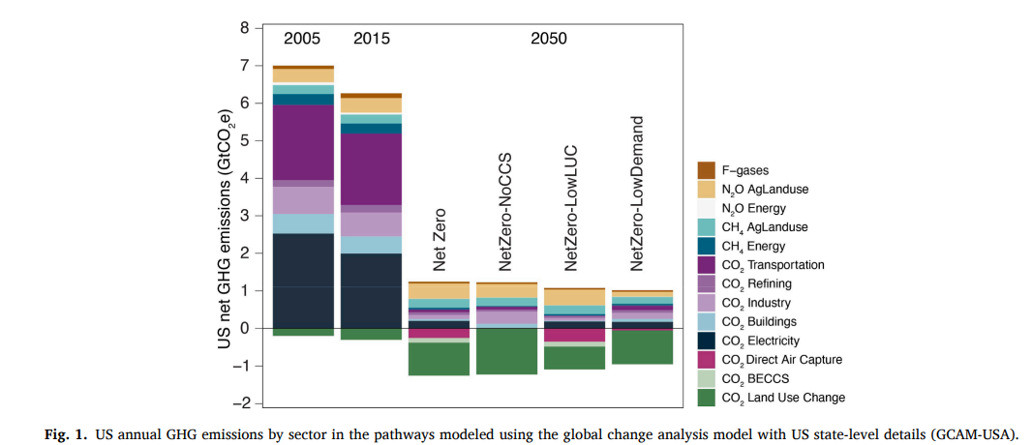
Climate Policy (Net-Zero) Scenarios
USA
The four net-zero emission pathways¹ each suggest that achieving the 2050 net-zero pledge entails rapid reductions of GHG emissions from all sectors.
The electricity and transportation sectors are projected to dominate the overall decarbonization.
Figure Source: Ou et al. 2023. State-by-state energy-water-land-health impacts of the US net-zero emissions goal, Energy and Climate Change, 4.
¹All pathways include the implications of COVID-19 on the economy, characterized by short-term energy demand reduction, as well as the latest technological trends as part of the GCAM-USA. Furthermore, all pathways incorporate existing state-level energy and emission policies, including state-specific Renewable Portfolio Standards (RPS) and Clean Energy Standards (CES), Regional Greenhouse Gas Initiative (RGGI), Corporate Average Fuel Economy (CAFE) standards, Zero-Emission Vehicle (ZEV) program, and existing nuclear moratoria. Globally, these net-zero pathways are consistent with a 1.5 ◦C-consistent mitigation pathway.
23
23

Slide 24
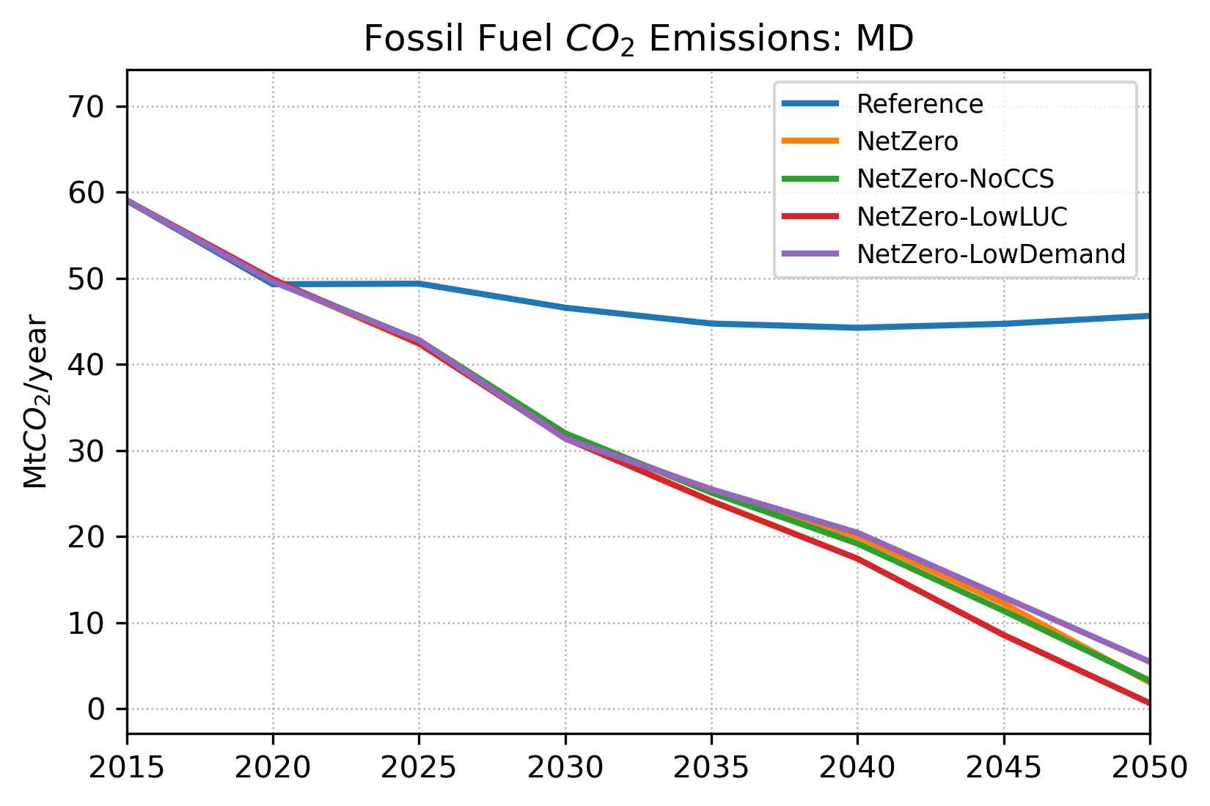
MD: GHG Emissions (1)
According to the 2024 State of Maryland Priority Climate Action Plan¹, more than 3/4 of MD’s current GHG emissions is comprised of CO₂ from energy and industry sectors.
Thus, fossil CO₂ emissions are a central point of interest in climate policies to mitigate GHG emissions in MD.
For MD, the Net-Zero scenarios imply large reductions in fossil CO₂ emissions in comparison with the Reference (i.e., ‘No-Policy’) scenario.
Achieving such emissions reduction levels will require profound transformations across sectors, and will lead to far-reaching economic and sustainability consequences.
MD
¹2024 State of Maryland Priority Climate Action Plan
Available at: https://www.epa.gov/system/files/documents/2024-03/mde-state-of-maryland-cprg-priority-climate-action-plan.pdf.
24
24

Slide 25
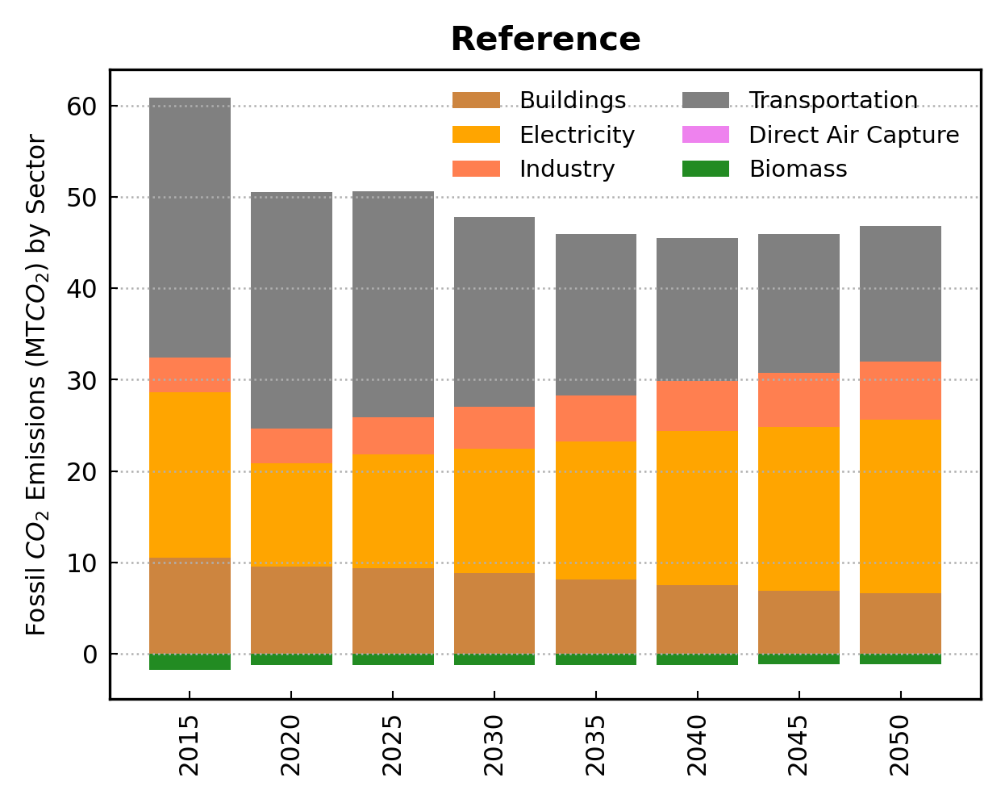
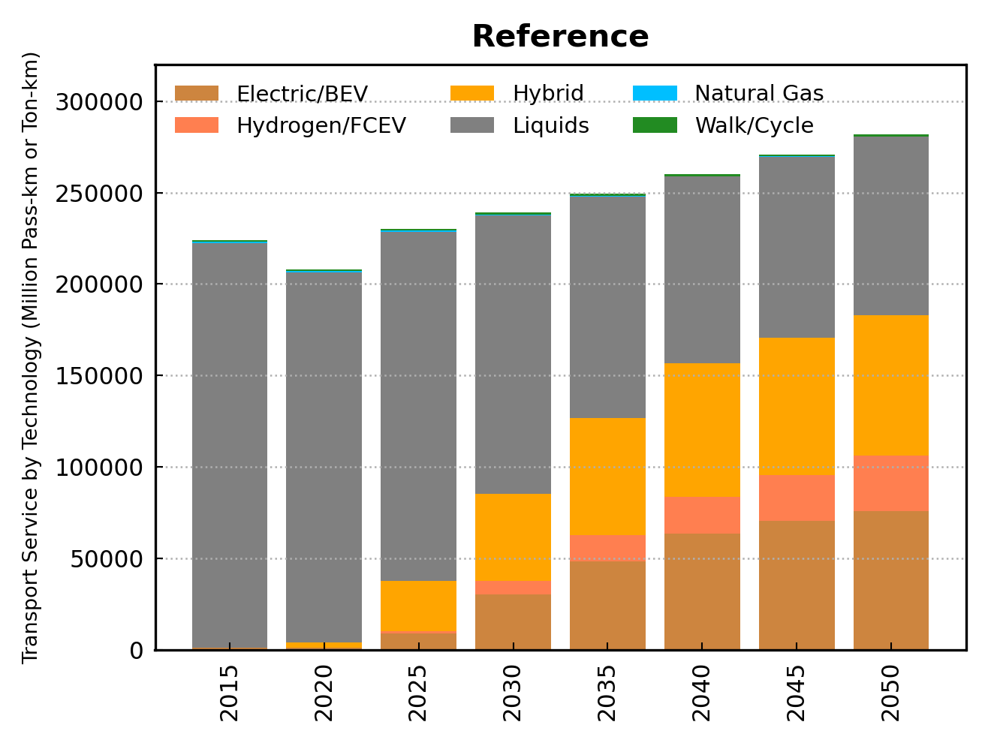
MD: GHG Emissions (2)
Presently, the electricity and transportation sectors are the major emitter sectors in MD.
Under the Reference scenario, fossil CO₂ emissions in MD is projected to decline by 2050 mostly due to reductions in the transportation sector.
The transportation sector is projected to face increasing development and adoption of electric vehicles, batteries and hydrogen fuel cells.
On the opposite trend, emissions from the electricity sector steadily grows.
25
25

Slide 26
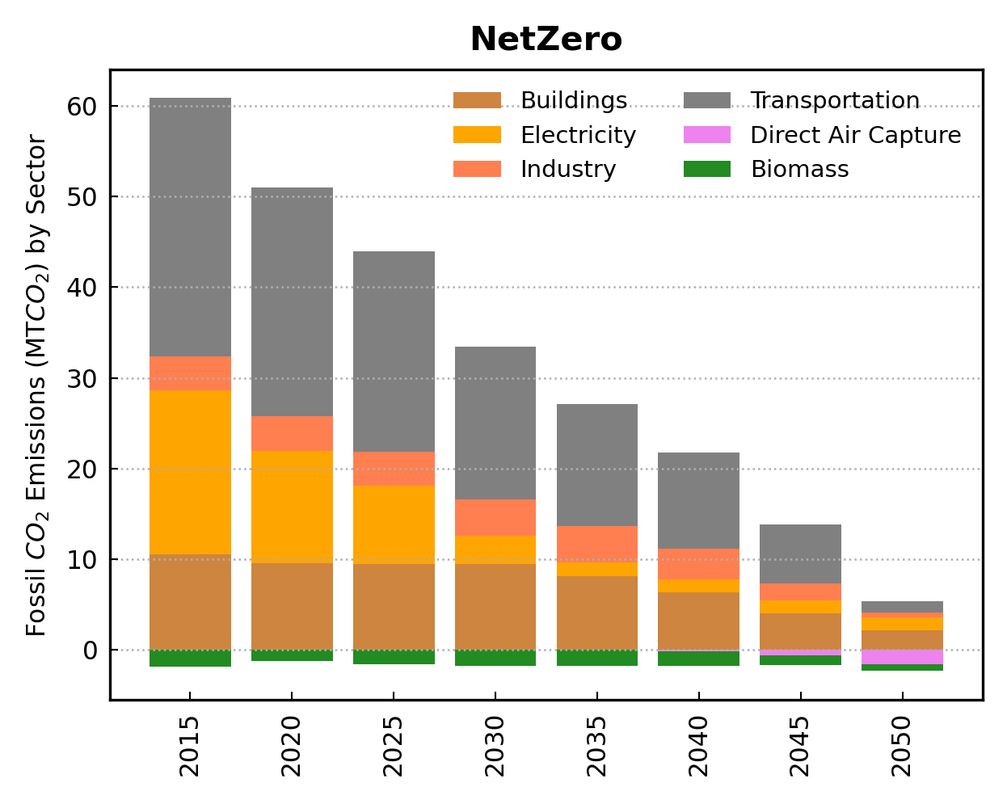
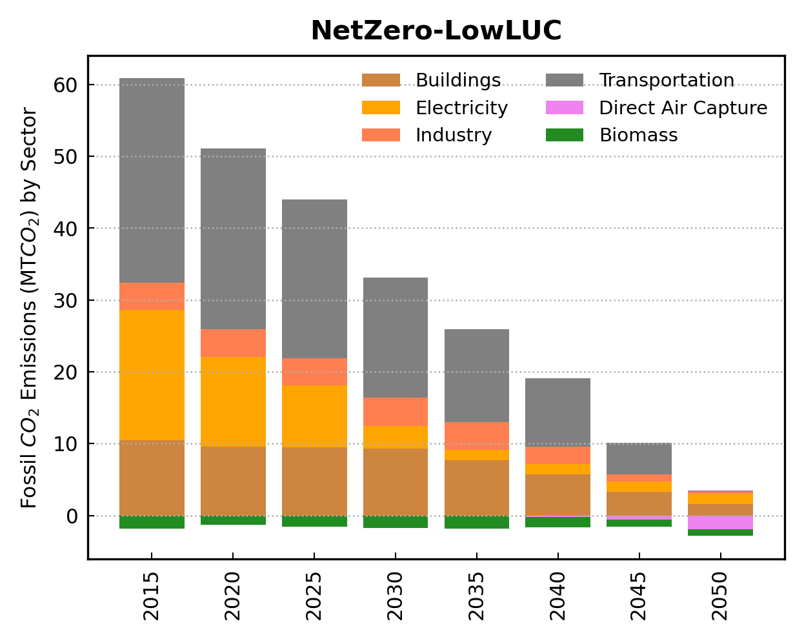
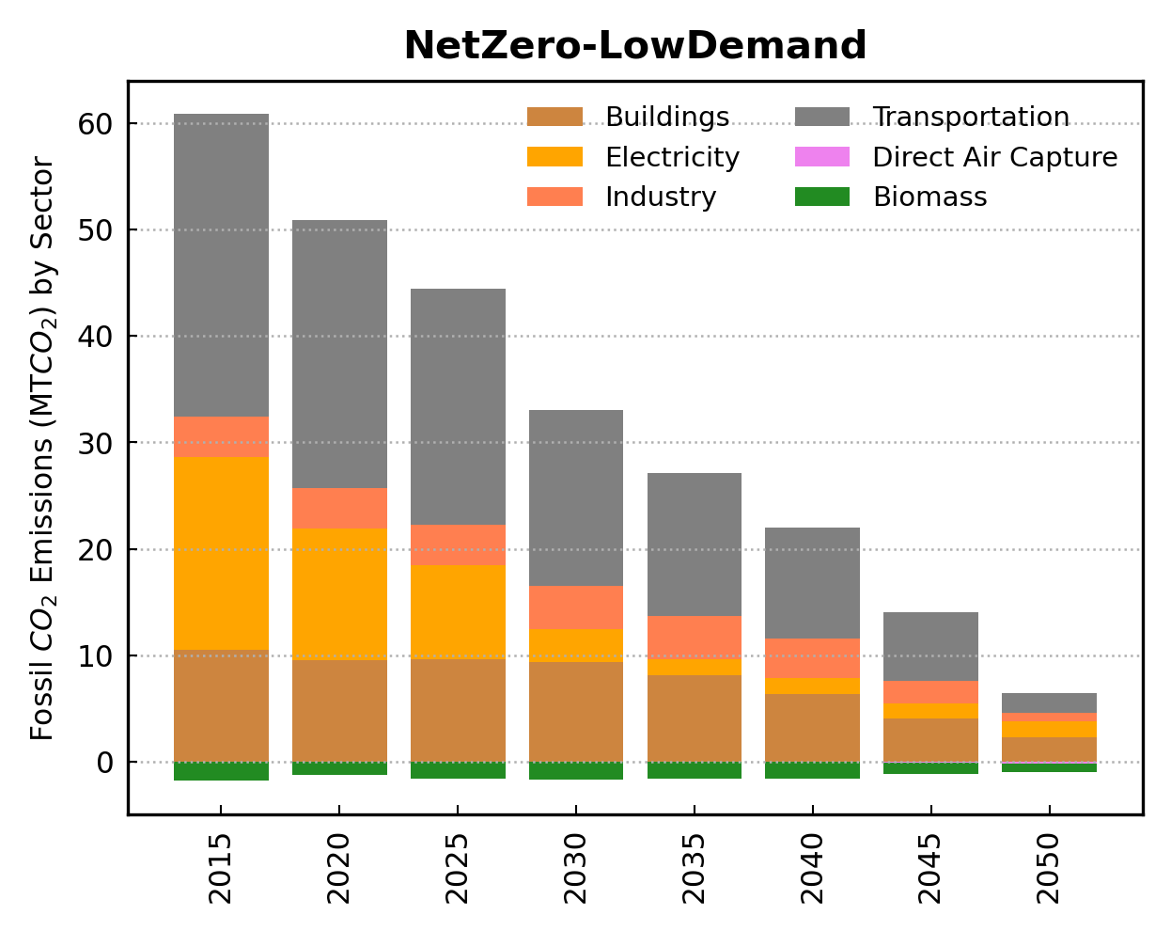
MD: GHG Emissions (3)
The Net-Zero pathways are associated with major reductions in fossil CO₂ emissions across the MD sectors by 2050.
These scenarios highlight the need of profound reductions in the power and transportation sectors.
The adoption of carbon dioxide removal (CDR) options, such as direct air capture (DAC) technologies, may be needed to compensate for emissions that are hard to abate.
26
26

Slide 27
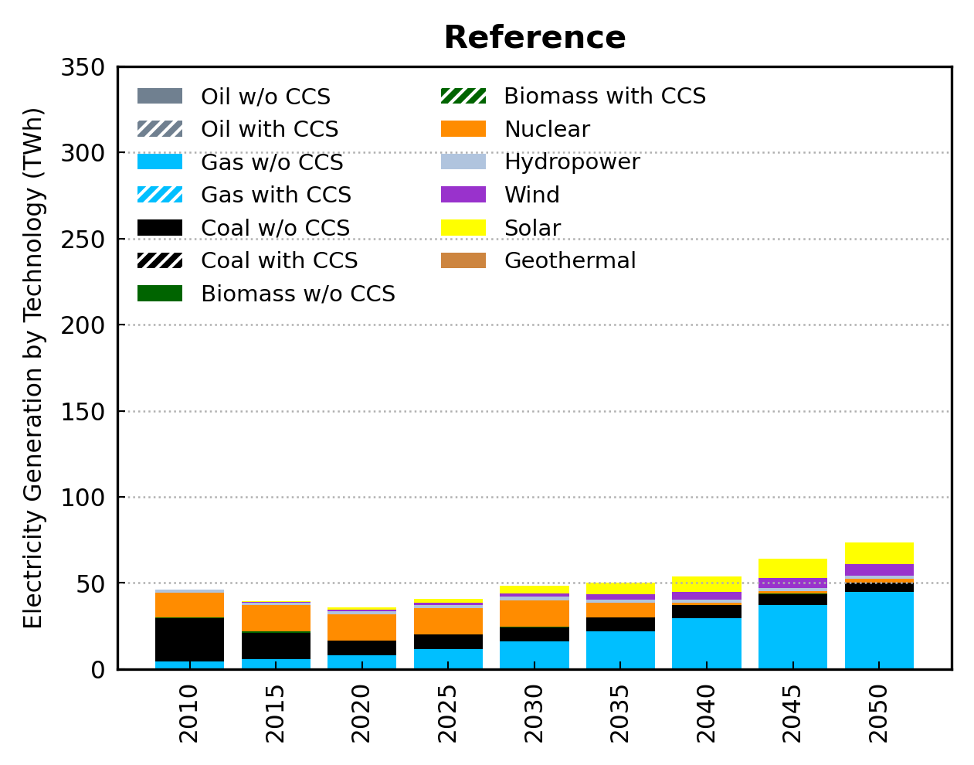
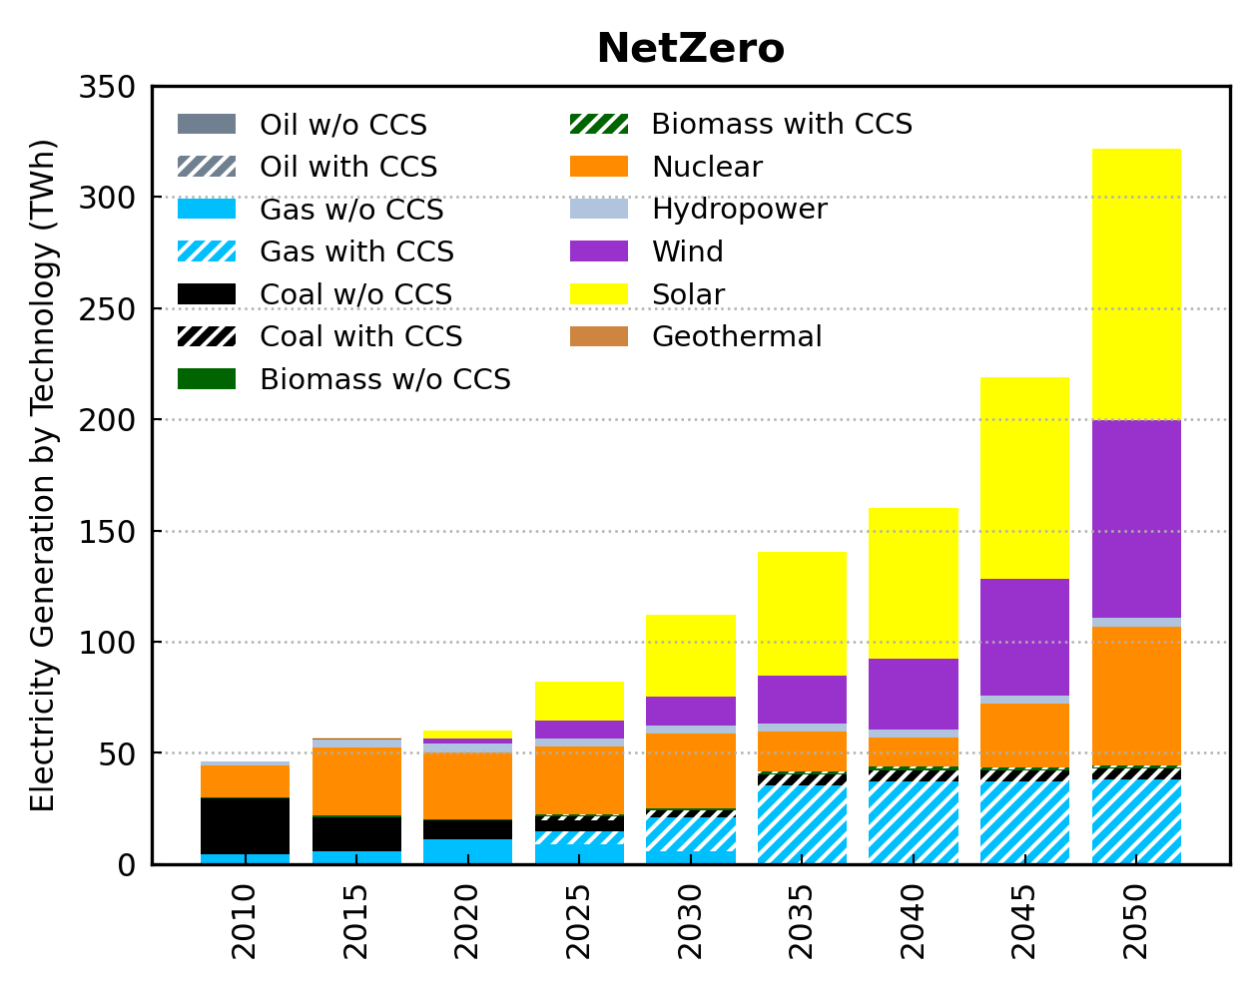
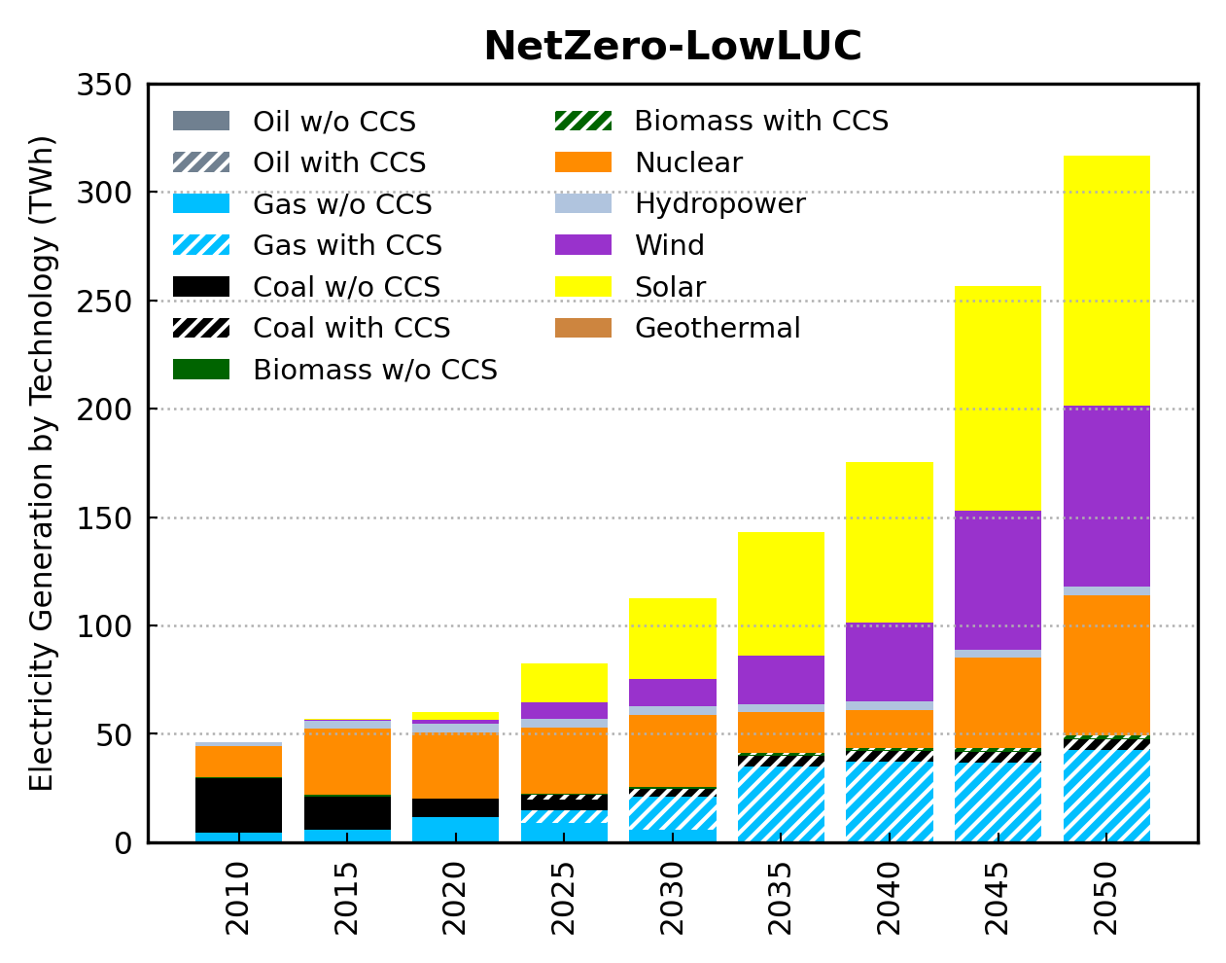
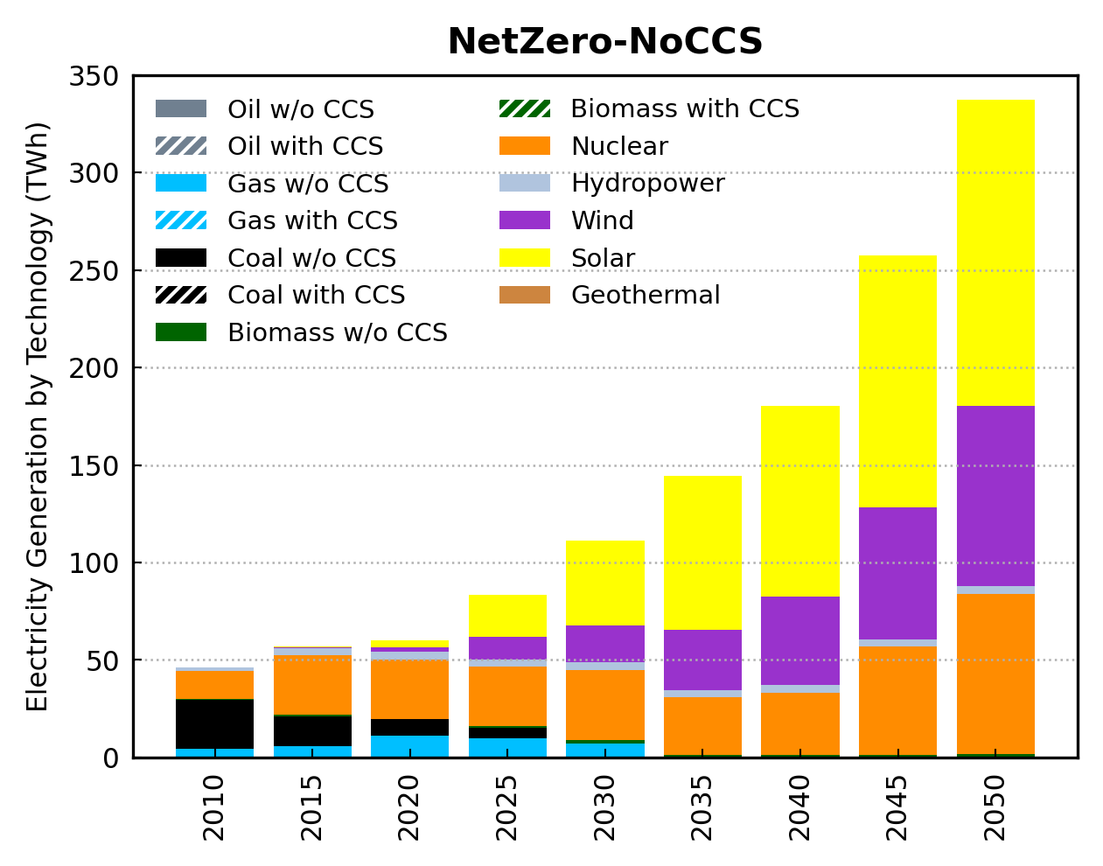
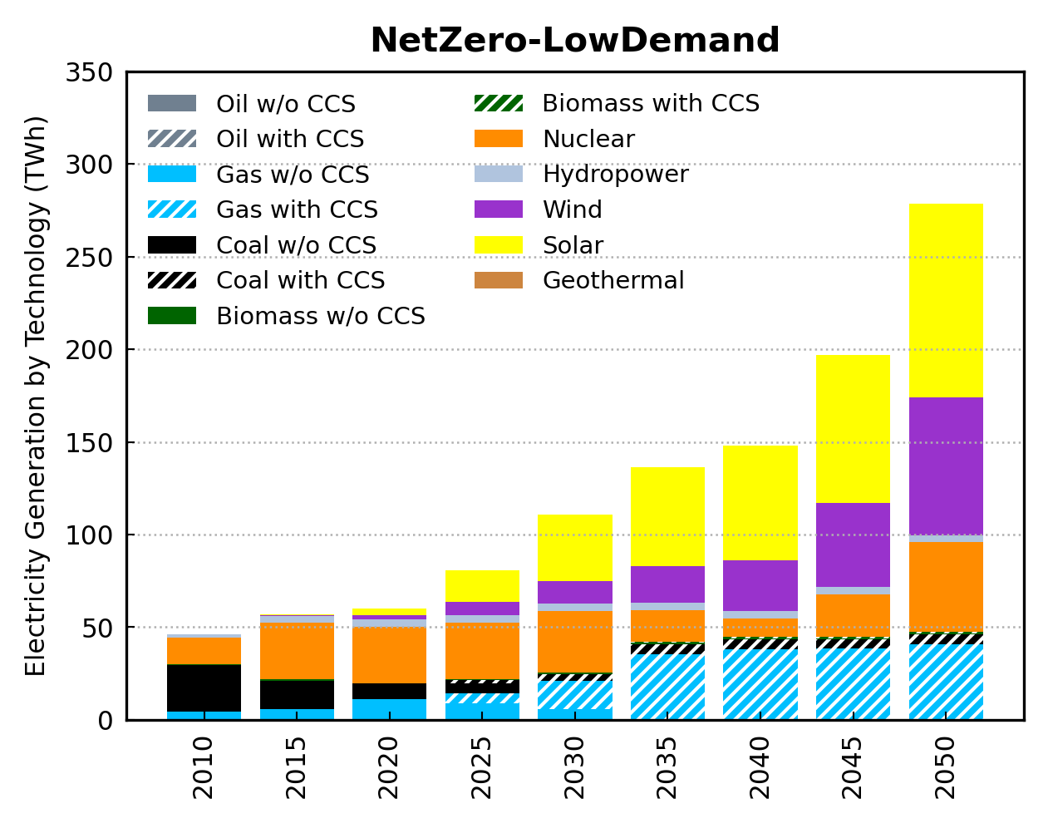
MD: Energy Sector (1)
To contribute toward the US climate goals, a profound transformation of the MD’s electric power sector is needed to meet the growing needs of electrification across sectors.
Extensive adoption of low-carbon technologies, and possibly of carbon removal technologies, such as carbon capture and storage (CCS) are needed.
This implies significant capital turnover with large capital investments in a clean grid and the possibility of stranded assets in the power sector.
27
27

Slide 28
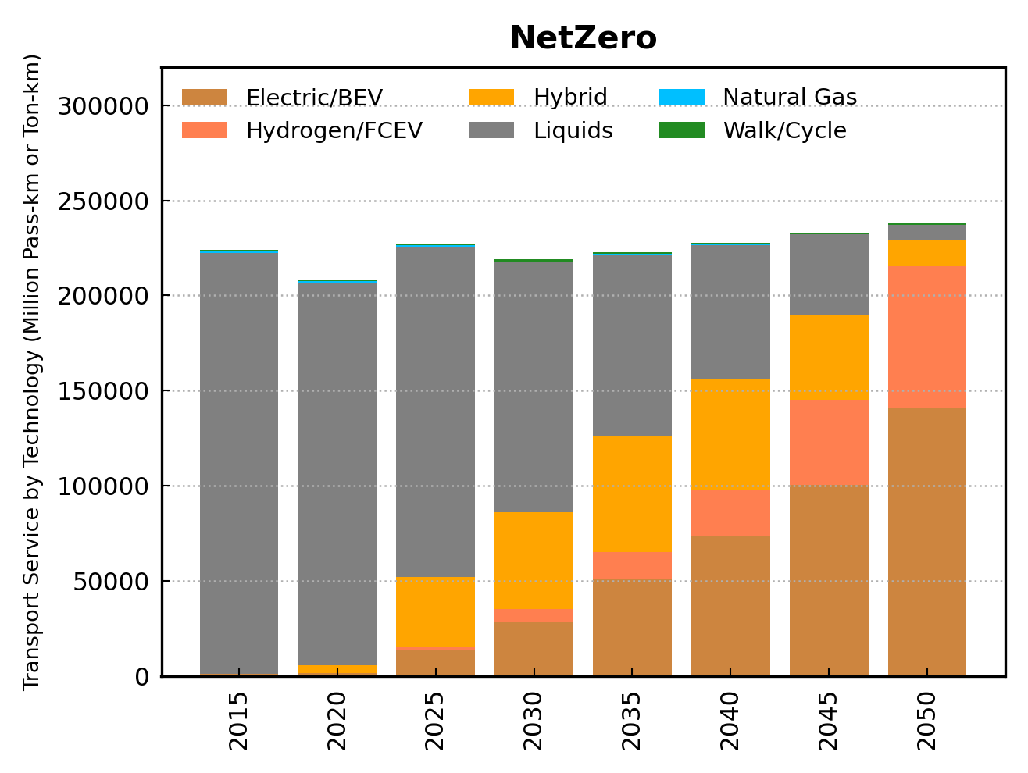
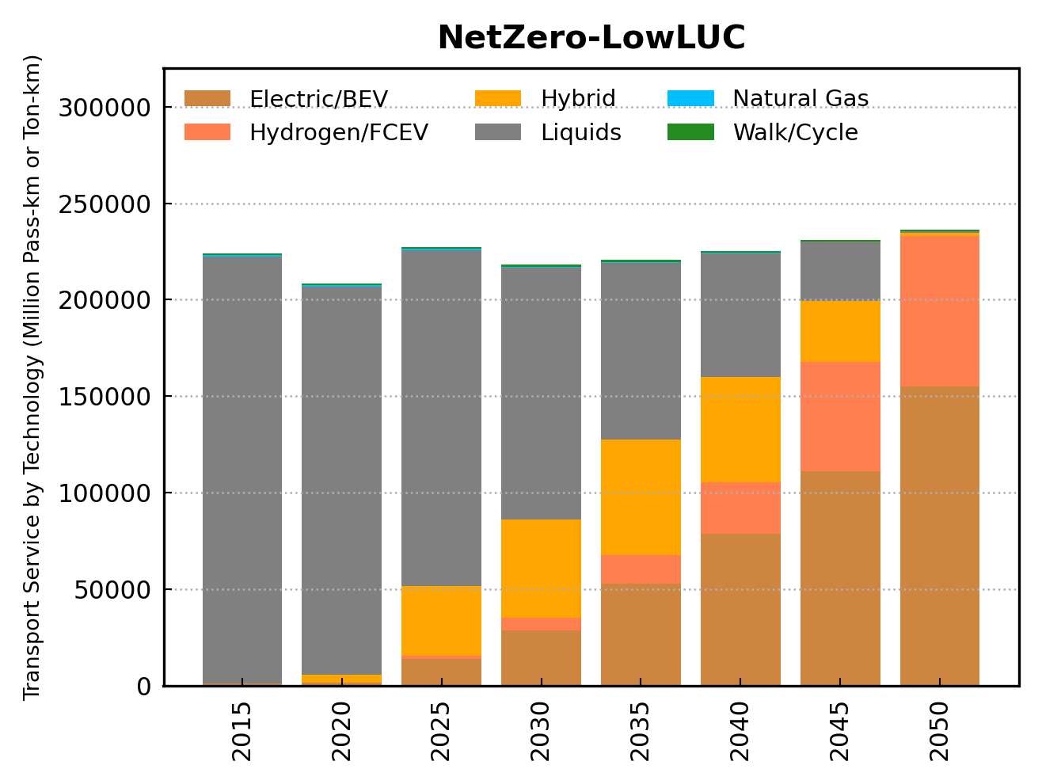
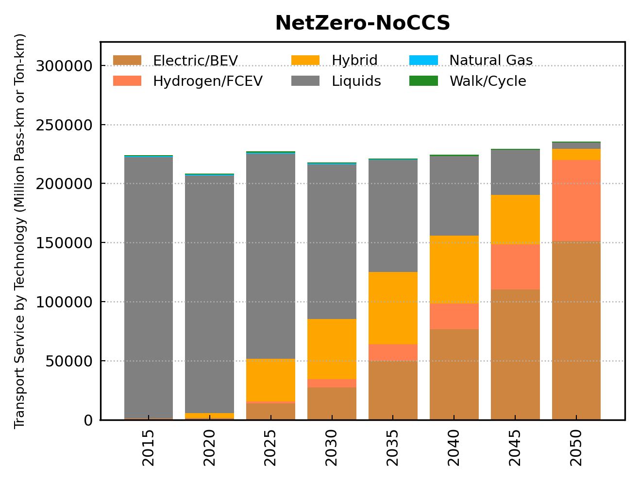
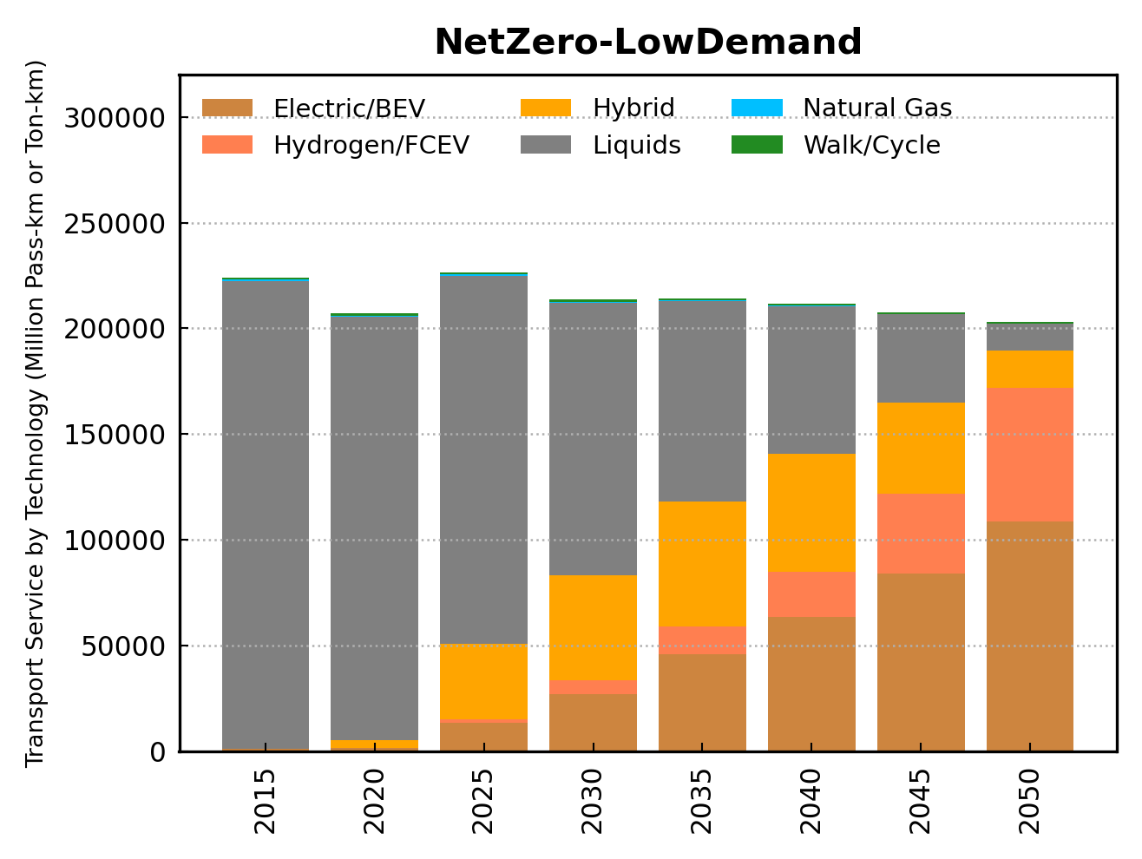
Energy Sector (2)
Under the Net-Zero pathways, the transportation sector is projected to:
drastically reduce the consumption of oil liquids.
rely considerably more on electric vehicles, batteries and hydrogen fuel cells over the coming decades.
28
28

Slide 29
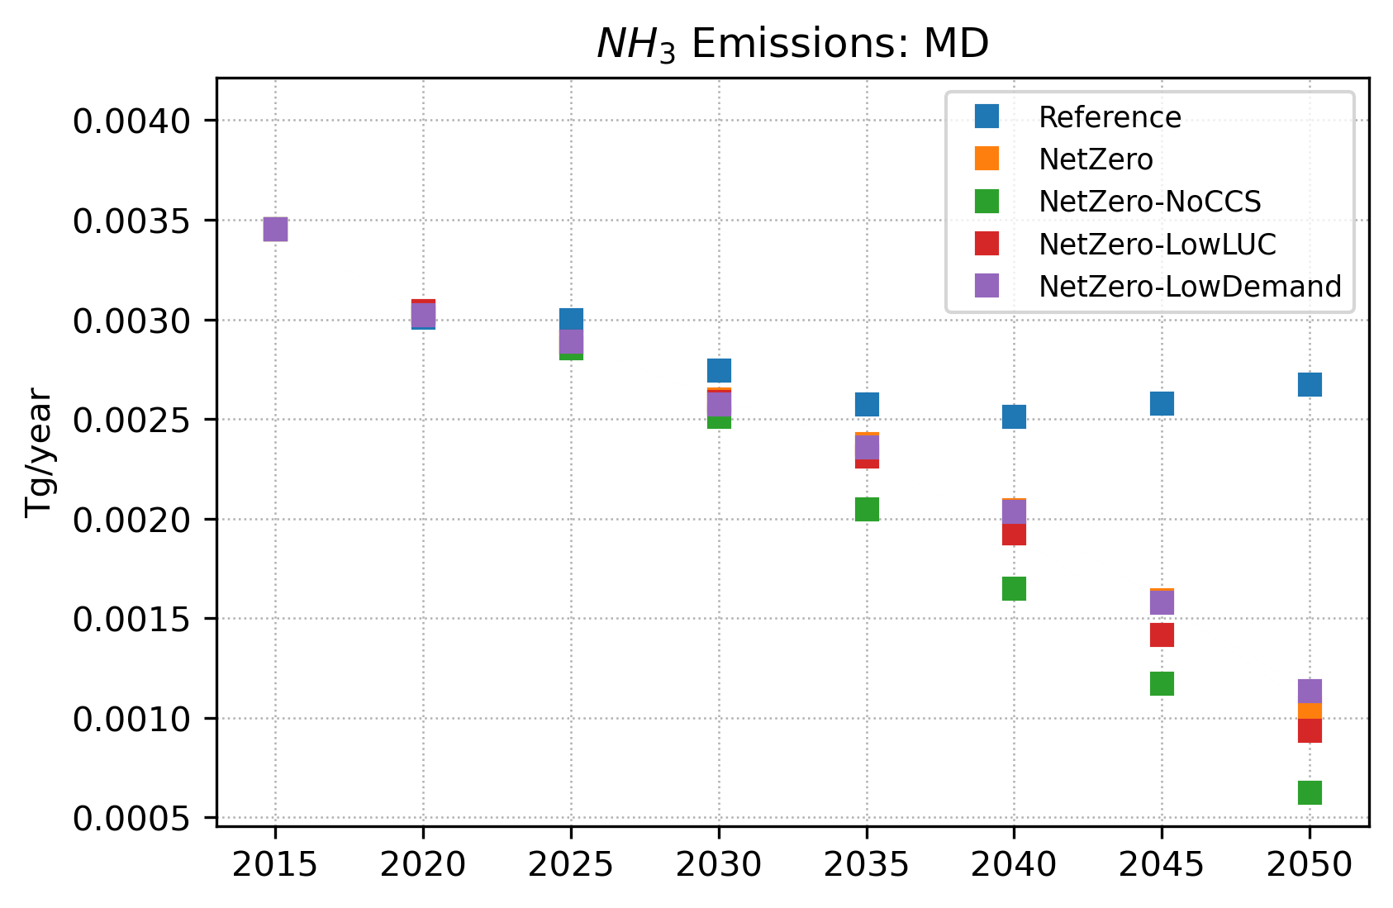
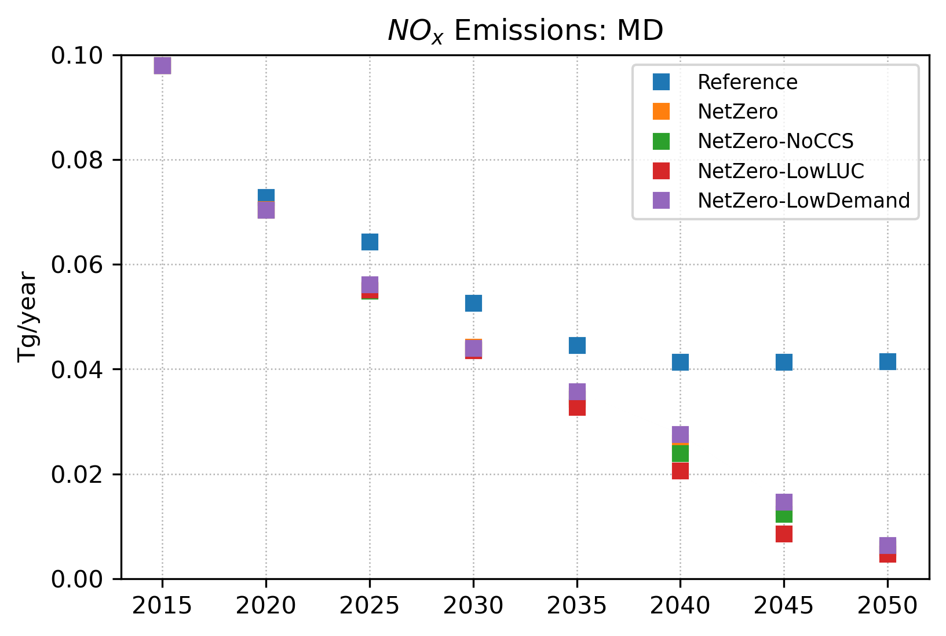
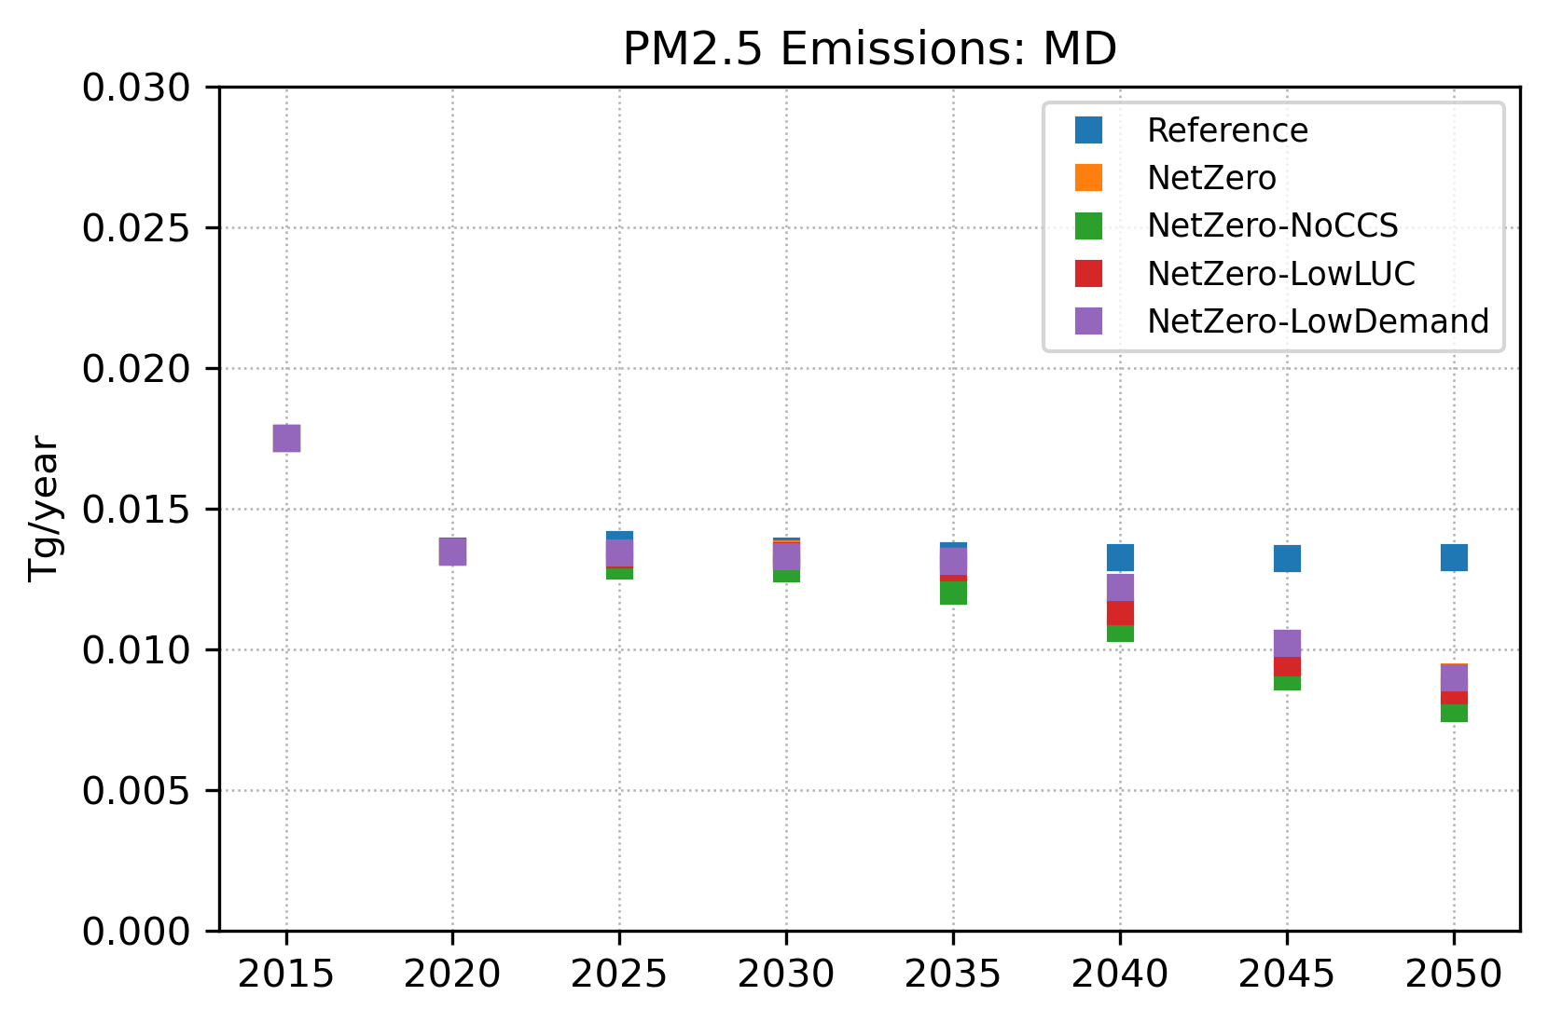
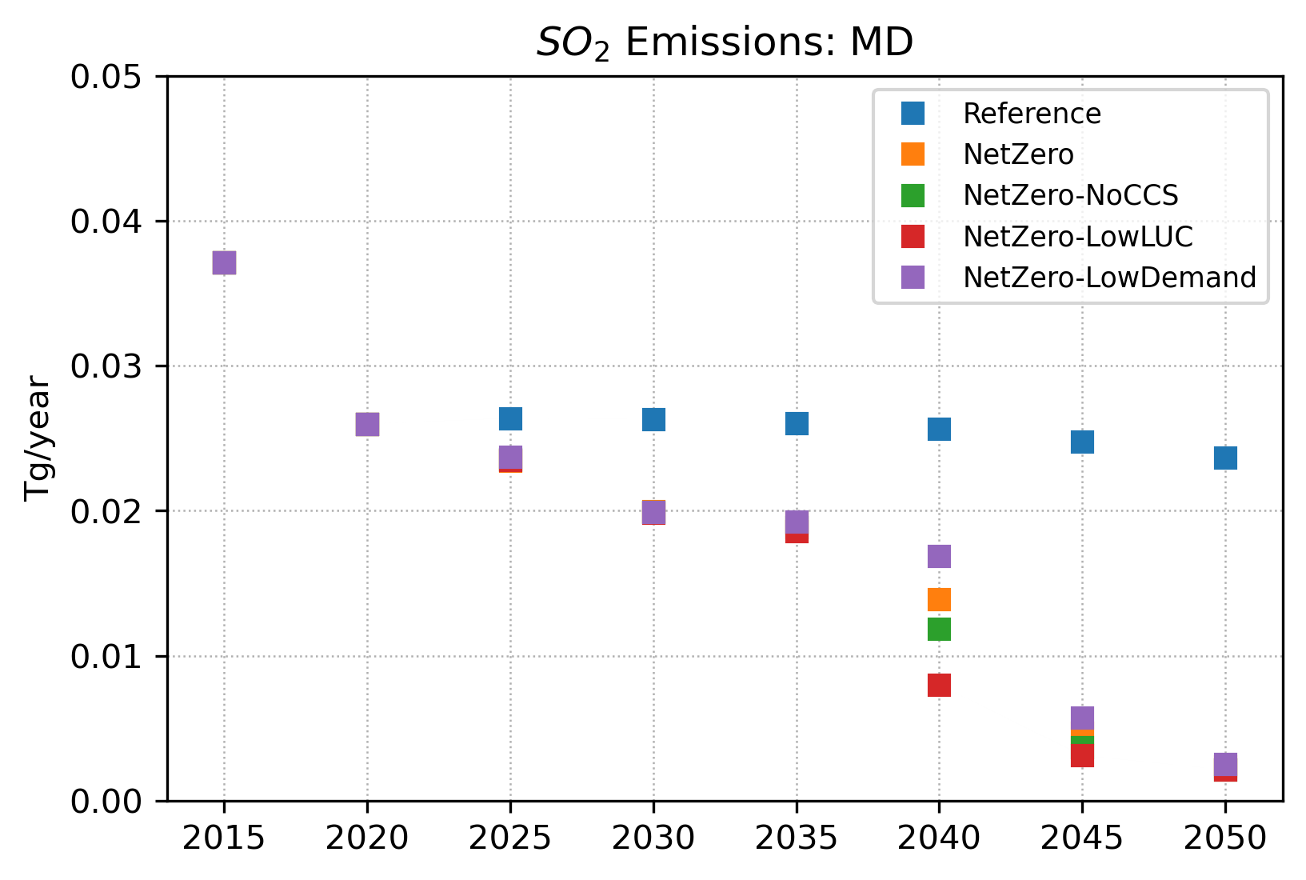
Implications of Net-Zero Pathways for Health
Emissions sources such as factories, motor vehicles, and electric utilities contribute to total concentrations of PM2.5 by emitting PM2.5 and its precursors, including nitrogen oxides (NO_{x}), sulfur dioxide (SO₂), and ammonia (NH₃).
Decarbonization toward net-zero emissions could lead to reduced mortality costs related to air pollutants.
The co-benefits for human health are due to decreasing fossil fuel use and increased electrification in all energy sectors.
All Net-Zero pathways are associated with large reductions in major air pollutants.
29
29

Slide 30
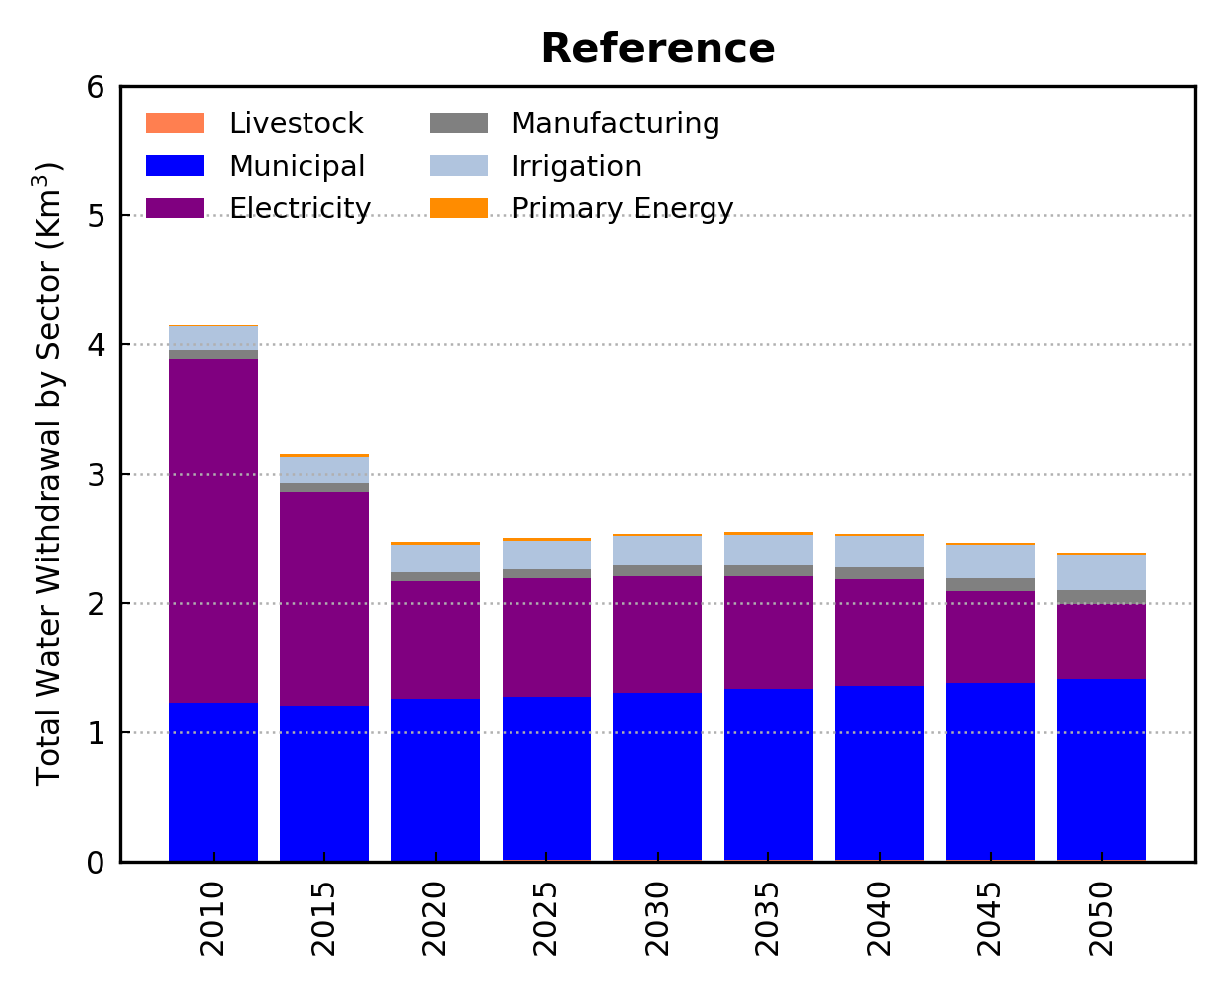
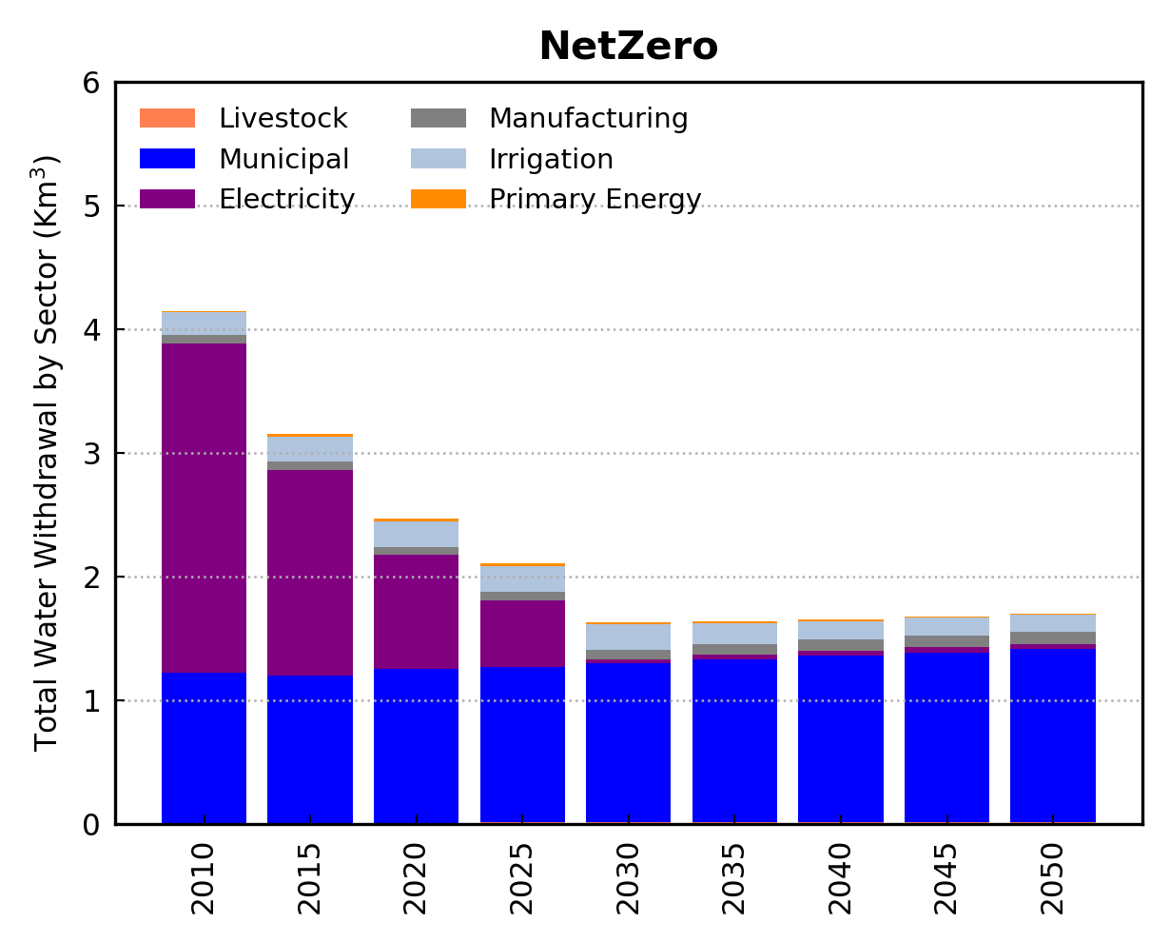
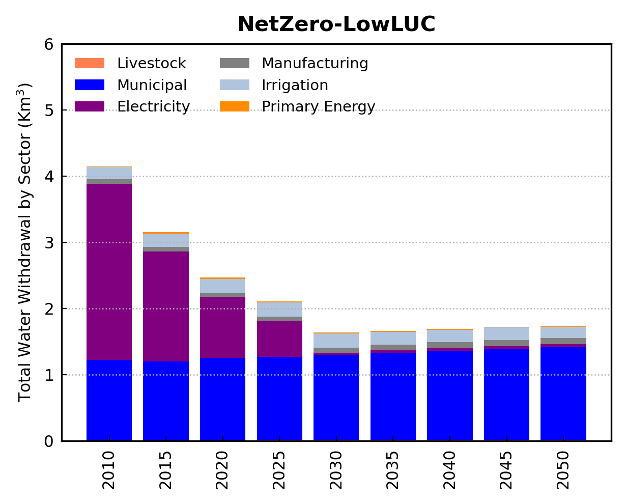
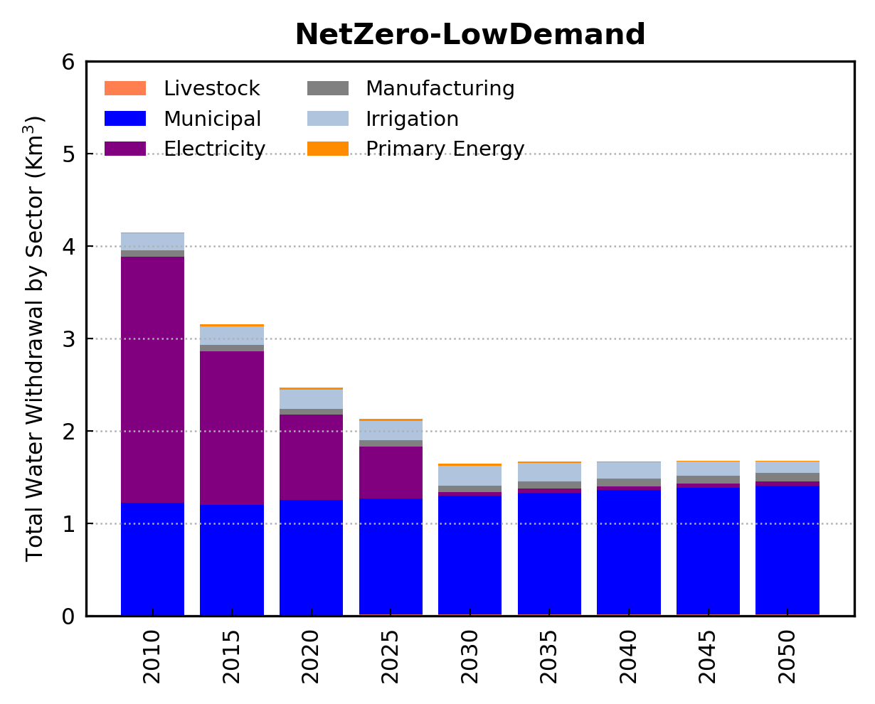
Implications of Net-Zero Pathways for the Water Sector
The Net-Zero pathways could imply other environmental co-benefits for the water sector.
All Net-Zero pathways are associated with reduced water withdrawals compared with the Reference scenario.
These benefits results from decreasing fossil fuel use mostly in the electric power sector where water-intensive fossil generation technologies are replaced by water-saving technologies such as wind/solar.
30
30

Slide 31
Conclusions
GCAM is a global integrated assessment model that characterize the interactions among human and earth systems.
A version of GCAM with U.S. state-level resolution (GCAM-USA) is useful to understand subnational energy–water–land interactions.
For example, GCAM-USA allows the understanding of heterogeneous patterns of synergies and trade-offs across US states due to climate mitigation policies.
GCAM-USA highlights that achieving ambitious GHG emissions reductions such as those required by the US Net-Zero target should have profound economic and sustainability implications for the state of MD.
31
31

Slide 32
Questions (?)

